Slide 1

Digital labour platforms: a global picture
Uma Rani
Senior Economist
Research Department, ILO

Slide 2
How do we define platforms?
    For the purposes of this Convention 193:
    (a) the term “digital labour platform” means a legal person or, where applicable under national law, natural person that, through digital technologies, using automated decision-making systems:
    (i) organizes and/or facilitates work performed by persons for remuneration or payment, for the provision of service, upon request of the recipient or requestor;
    (ii) regardless of whether that work is performed online or in a specific geographic location.

Slide 3
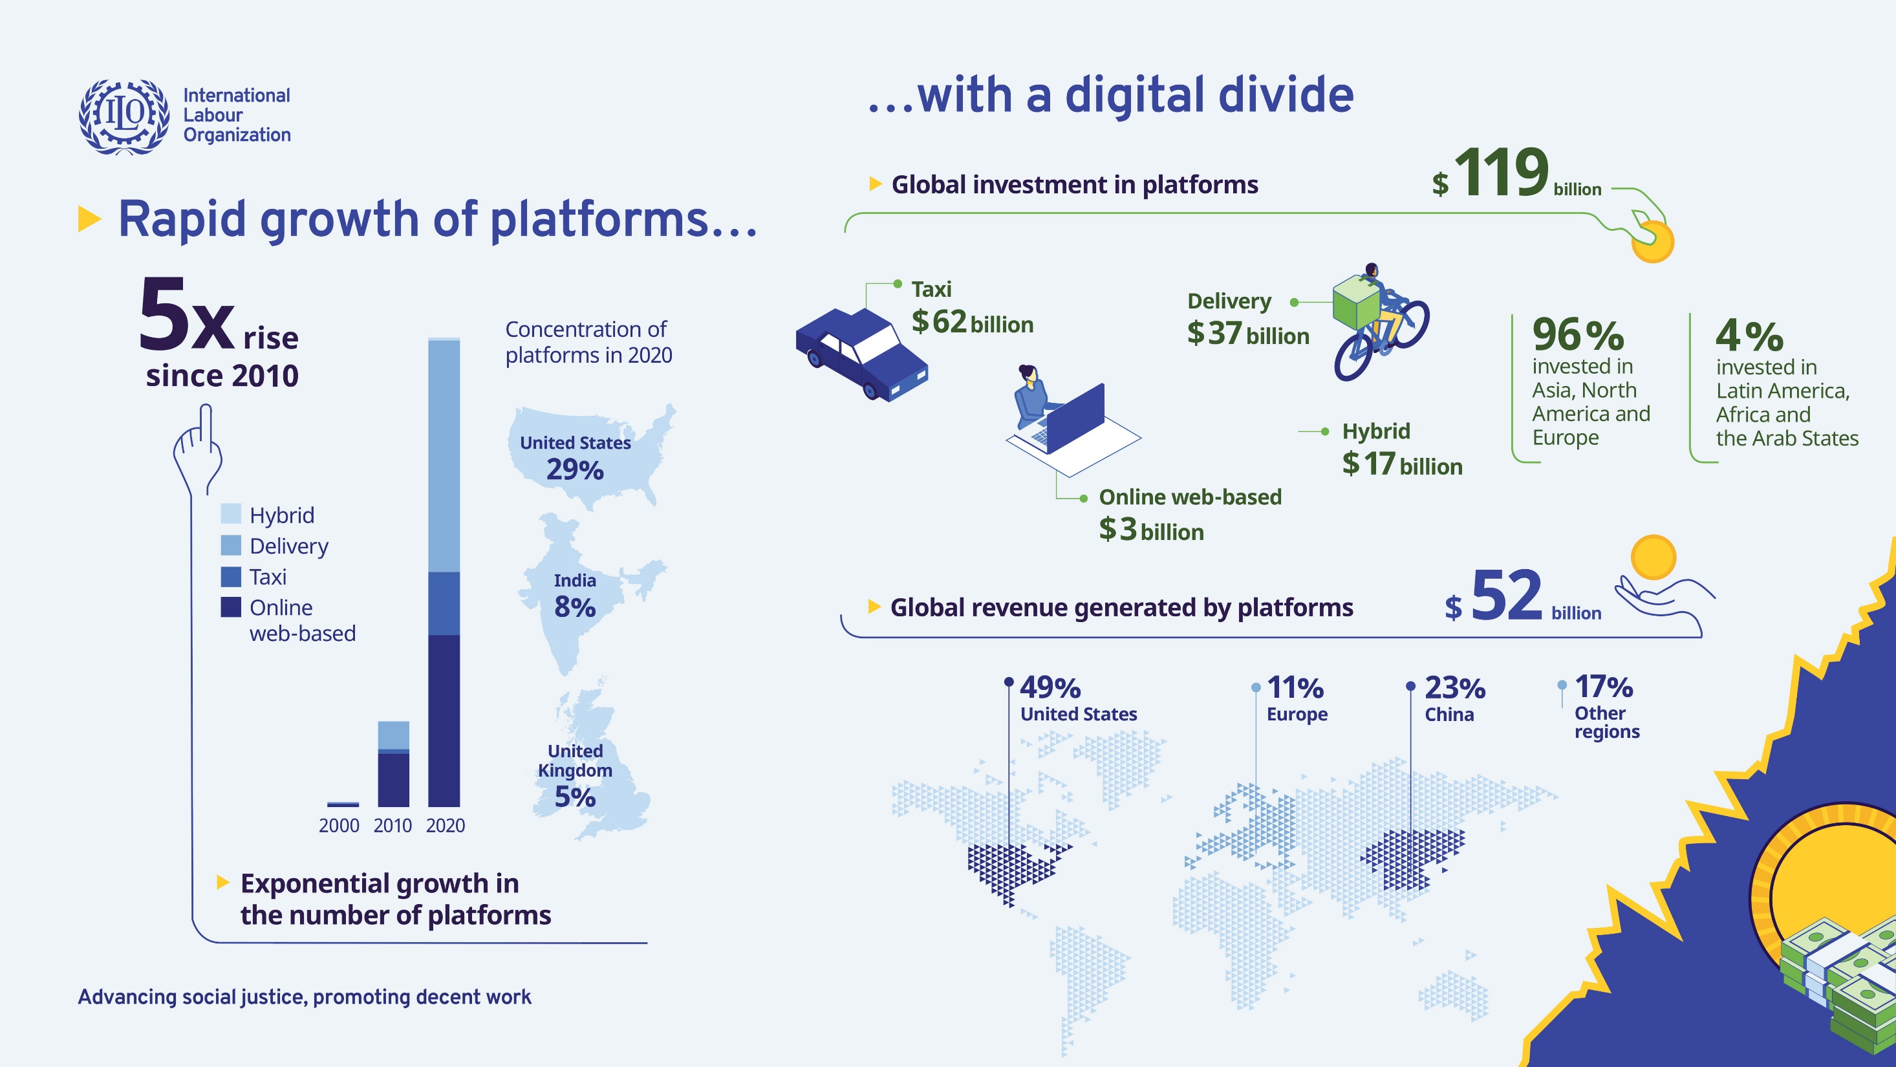

Slide 4
Penetration of digital platforms in different sectors of the economy
Education
Byju’s ~ Unacademy ~ Vedantu
Software coding/programming
Topcoder ~ HackerRank ~ Kaggle
Online web-based platforms
Microtask
FlexingIT ~ AMT ~ Clickworker
Freelance – All kinds of Professional services
Upwork ~ Freelancer ~ Toptal
Legal and Patent Services
VakilSearch ~ Legistify
Mediate work
Medical consultation
Practo ~ DigiQure ~ DocsApp
Digital labour platforms
Domestic services
SweepSouth ~ Batmaid ~ BookMyBai
Personal services
Task Rabbit ~ Doit4u ~ Urban Company
Location-based platforms
Ride-hailing
Uber ~ Bolt ~ Rapido
Logistics and Delivery
Deliveroo ~ Rappi ~ Zomato
Agriculture
DeHaat ~ Big Haat ~ Ninjacart
Healthcare
Care24 ~ Carelinx ~ Greymate care
Facilitate or mediate
exchange
Wholesale and Retail eCommerce
Amazon ~ Flipkart ~ Jumia
B2B and B2C platforms
Payment services
PhonePe ~ Razorpay ~ Paytm
Agritrading
Farm Crowdy ~ Agri10x ~ Ninja
Other digital services
Classifieds
Job Listings

Slide 5
Digital labour platforms
Online web-based platforms
Freelance (Upwork, Freelancer, Toptal)
Microtasks (Playment, MTurk, Clickworker)
Competitive programming and scientific research (Topcoder, HackerRank, Kaggle)
Location-based platforms
Taxi (Uber, Ola, Bolt)
Delivery platforms (Ubereasts, Swiggy, Rappi, Grab)
Domestic services (SweepSouth, Meetmybai, Batmaid)
Contest based (99designs, Designhill, DesignCrowd)
Beauty services (Urban clap)

Slide 6
Home-based workers on digital labour platforms
Online web-based platforms
Freelance (Upwork, Freelancer, Toptal)
Microtasks (Playment, MTurk, Clickworker)
Competitive programming and scientific research (Topcoder, HackerRank, Kaggle)
Other platforms
E-commerce platforms
Social media platforms (Facebook, Instagram)
Other platforms (such as Whatsapp)
Contest based (99designs, Designhill, DesignCrowd)

Slide 7
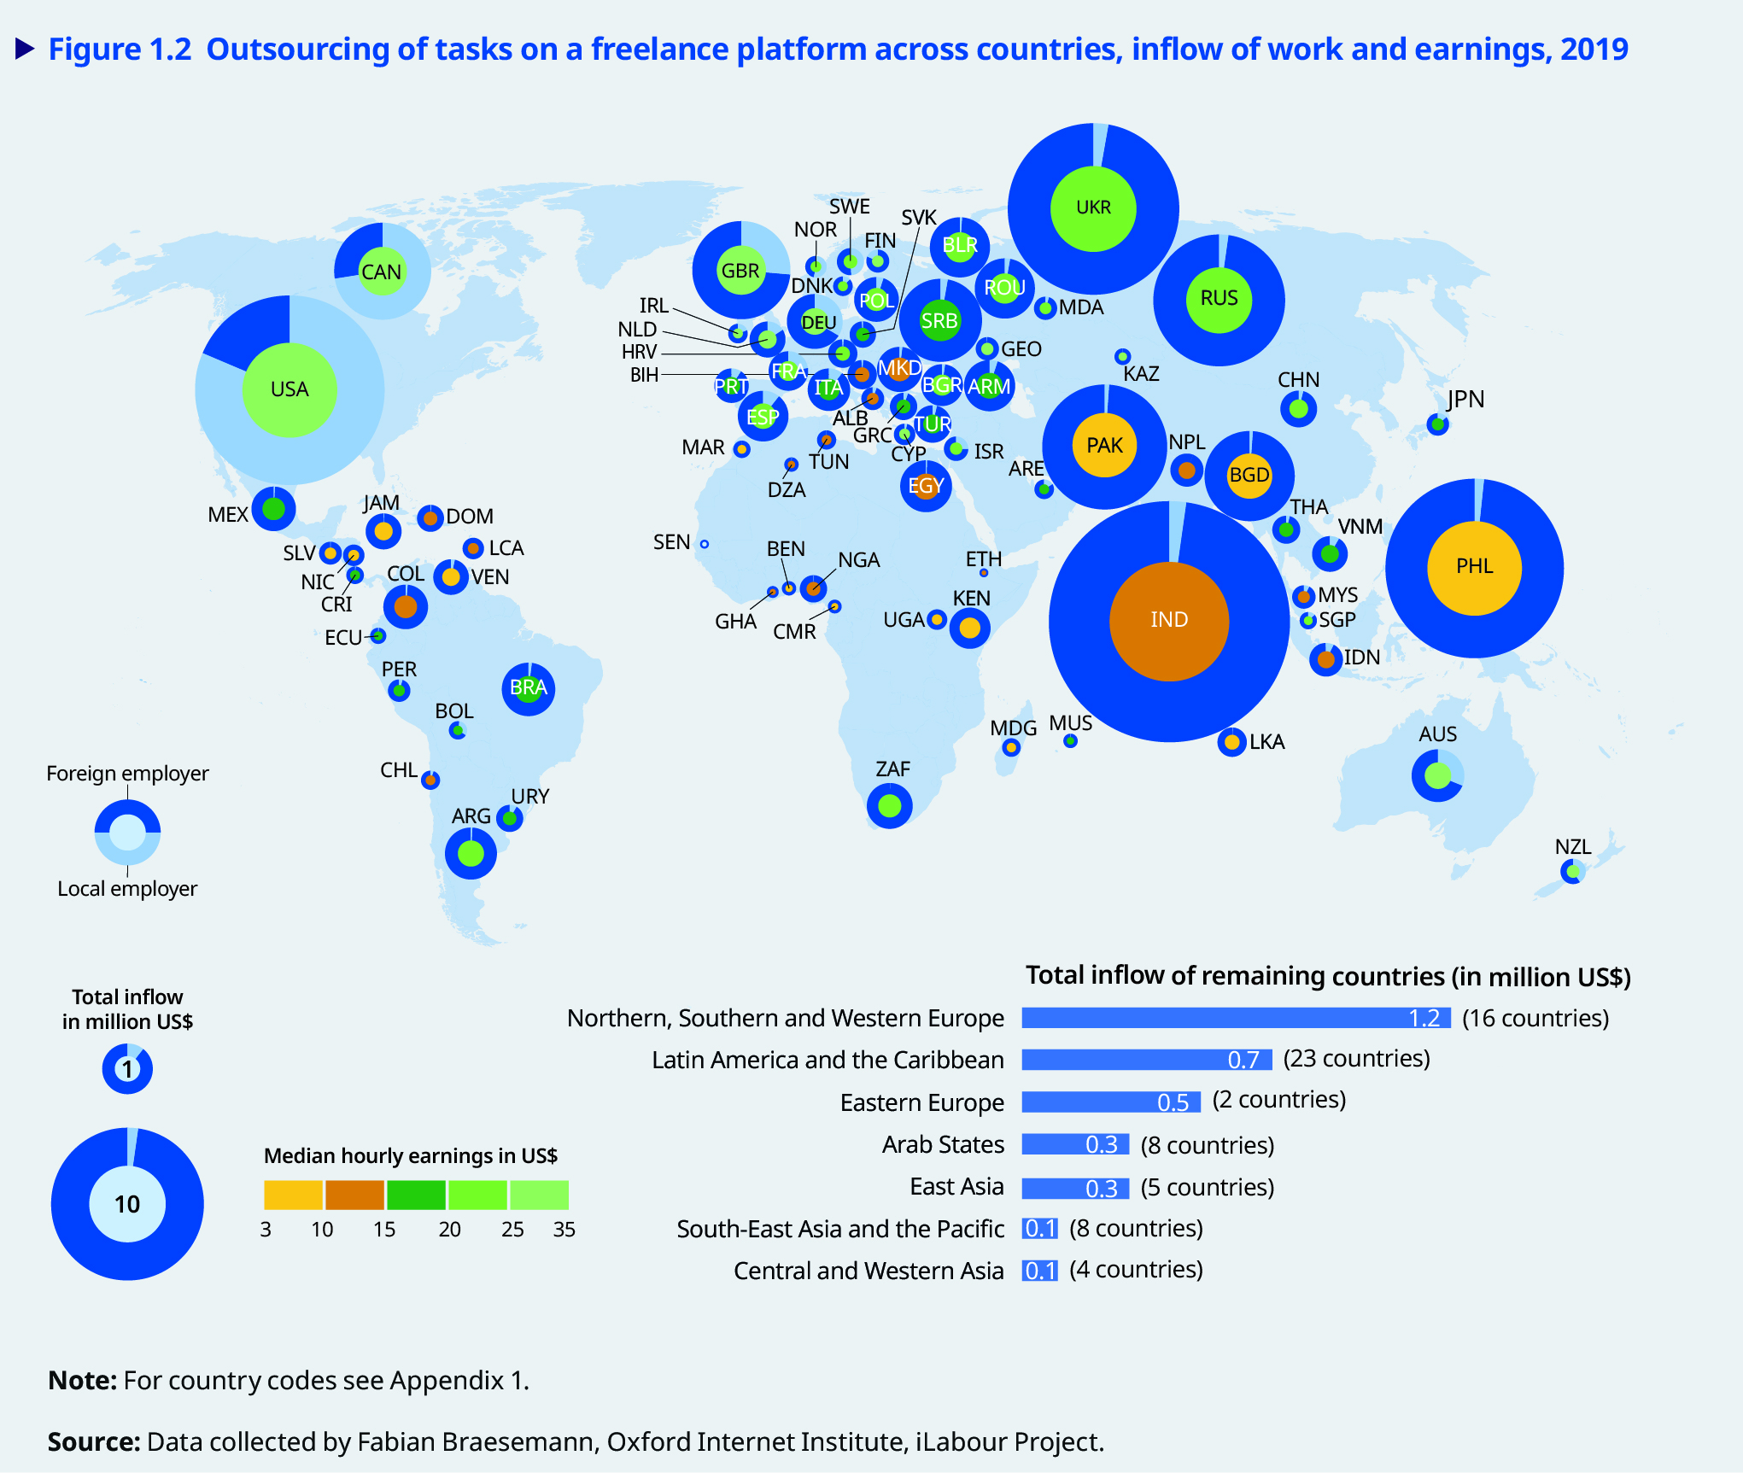
Outsourcing of tasks on a major freelance platform:
Inflow of work and earnings, 2019

Slide 8
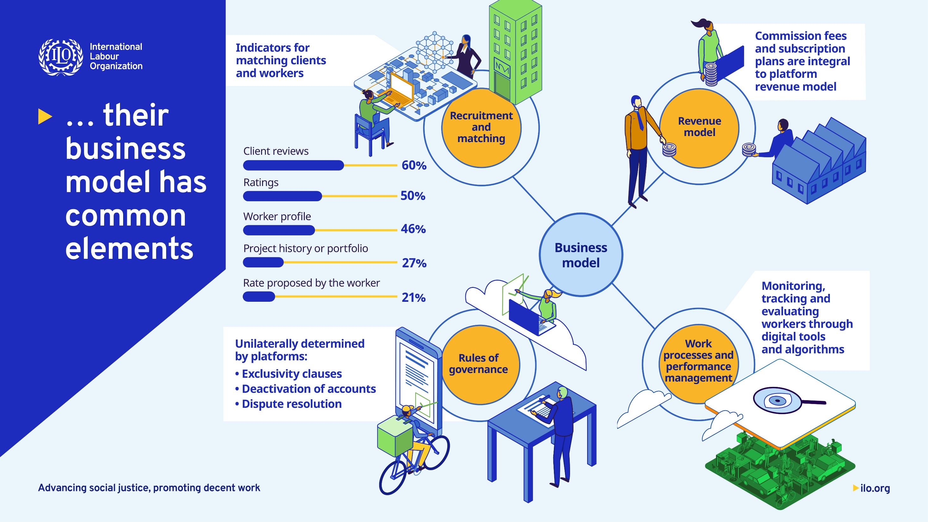

Slide 9
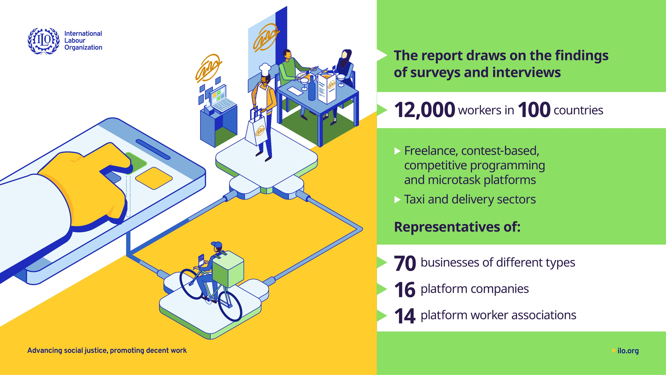

Slide 10
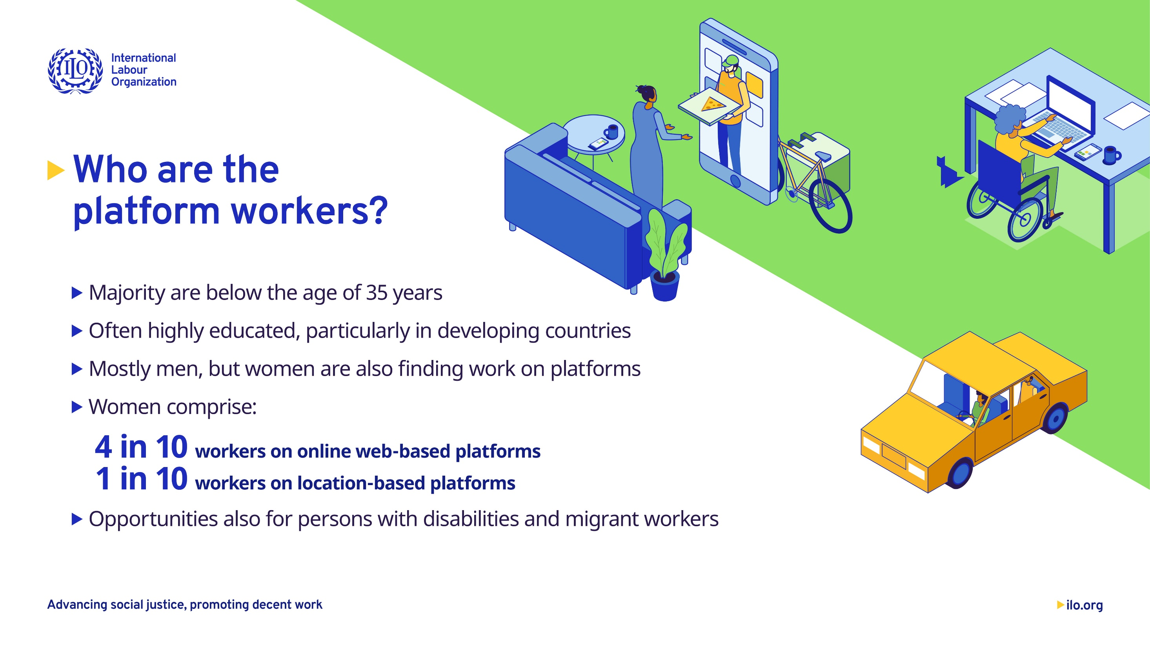
Classified as independent contractors or partners or self-employed

Slide 11
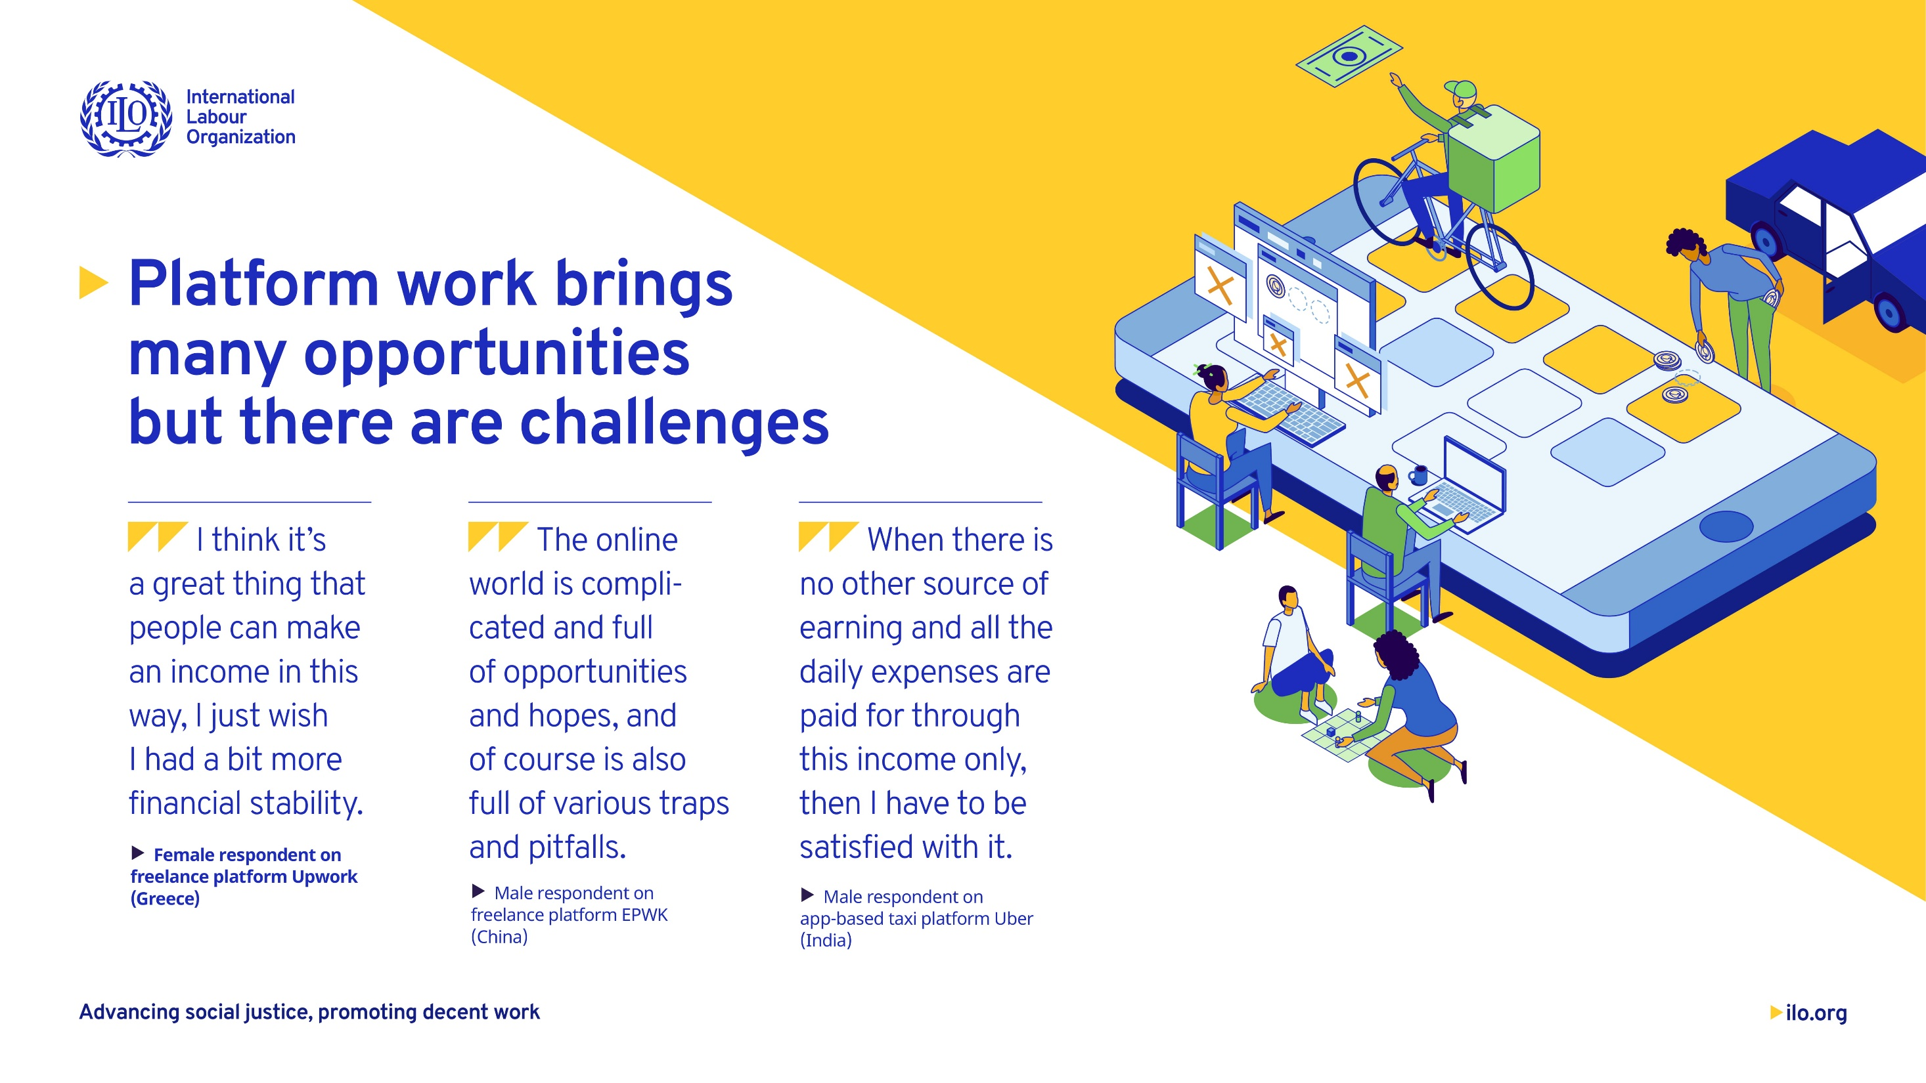

Slide 12
Indeed, there are a number of challenges…
    Employment relationship
    Earnings – Low earnings, commission fees and different types of fees, unpaid hours of work
    Working time – Long working hours, risks and stress
    Occupational safety and health
    Social protection: Large gaps in health insurance; work-related injury provision; unemployment and disability insurance; and old-age pension or retirement benefits.
    Deactivation of accounts & dispute resolution mechanism
    Algorithmic management defining the everyday experience of the workers – ratings, rejection, monitoring, deactivation
    Data protection

Slide 13
Challenges faced by sellers in India, Kenya & Uganda
    Kenya (largely platforms), Uganda (largely social media & whatsapp) and India (mixed)
    Pricing, based on prices charged by competitor sellers on the platform; logistics and shipping fees (45 per cent); the cost of raw materials and intermediate goods (40 per cent); and packaging costs (38 per cent)
    Different types of fees they incur for promoting visibility, cataloguing, transactions, penalties and fines for order cancellations or product returns
    Commission fees and subscription plans for using the platforms
    Non-payments by customers

Slide 14

Context of developing countries…
High levels of informality
Taxi drivers, delivery workers, domestic workers, personal
service workers are either self-employed or casual workers
  Flexibility, autonomy and control over their work
  Platforms further precariatise these workers using
  algorithmic management practices
High skilled service workers are being pushed into informality as a result of the rise of online freelance and talent or innovation or competitive programming platforms
Not new work, but work in the traditional economy being conducted or mediated using technology

Slide 15
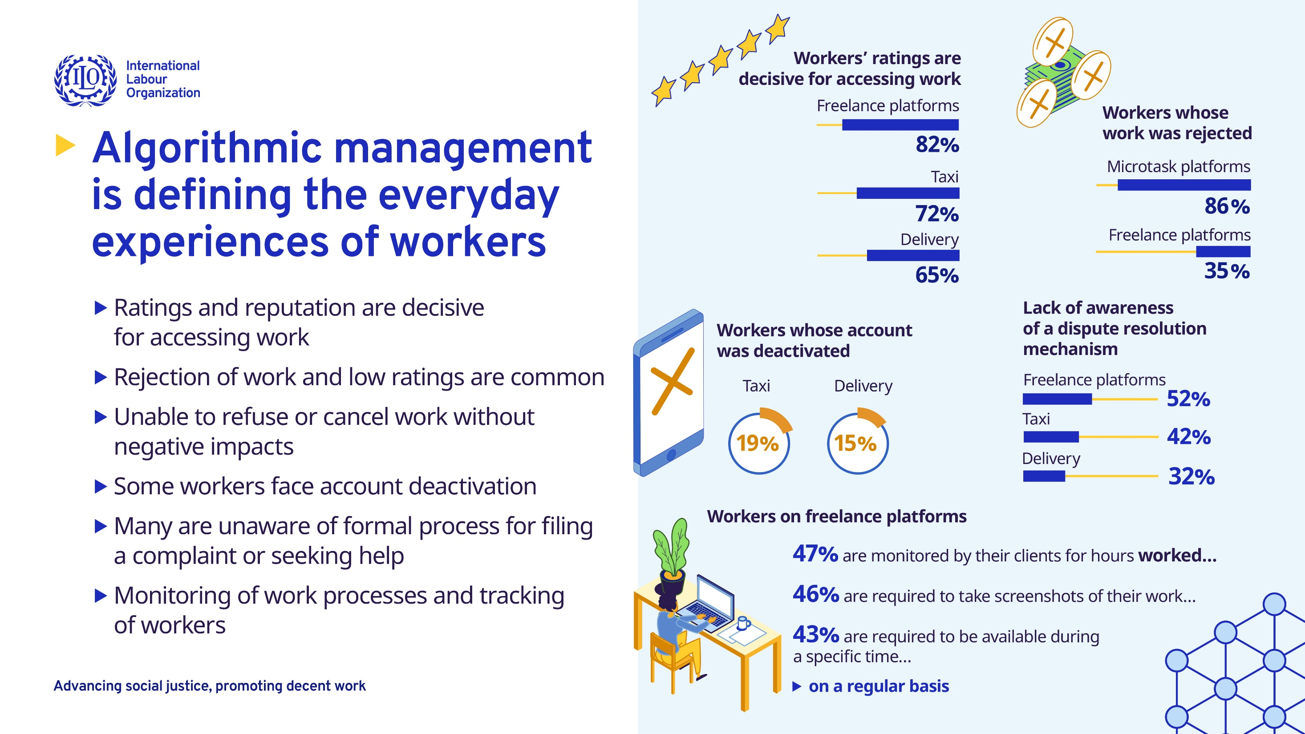

Slide 16
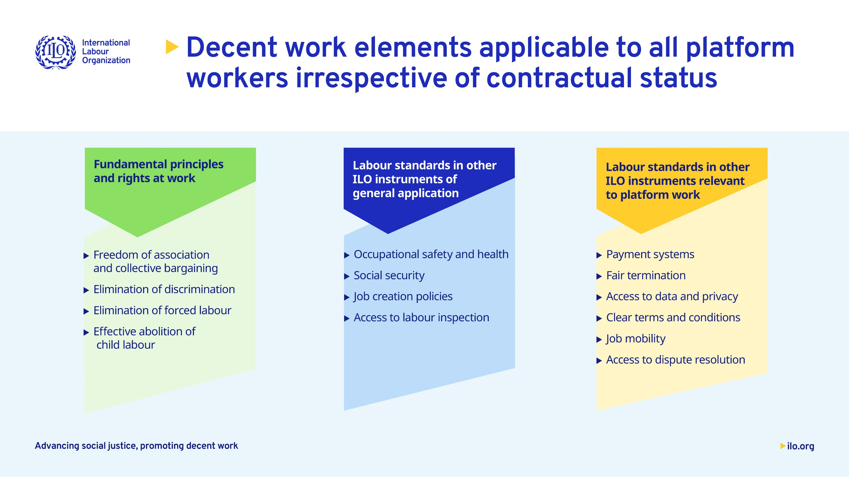

Slide 17
Normative gap analysis
Some ILO standards have direct applicability to platform workers whether they are in wage or non-wage employment
Existing standards do not address some of its specific characteristics, or do not address new developments driven by technological changes
Normative gaps on dispute resolution exist, particularly given the cross-border nature of work
Several standards have gaps in their scope, notably coverage of the self-employed
Notes:
This broad scope of application can be seen in standards relating to fundamental principles and rights at work, violence and harassment, employment promotion and some key principles concerning the protection of migrant workers
Labour Inspection Convention, 1947 (No. 81),
Their application to the platform economy may raise practical difficulties as work does not always take place in a unique workplace, as in the case of riders or drivers. Some participants in the Meeting of Experts indicated that algorithmic management constituted a barrier to effective labour inspection.
Labour Inspection Convention, 1947 (No. 81),
Their application to the platform economy may raise practical difficulties as work does not always take place in a unique workplace, as in the case of riders or drivers. Some participants in the Meeting of Experts indicated that algorithmic management constituted a barrier to effective labour inspection.

Slide 18

Scope of regulatory intervention in Member States
Amendments to existing labour legislation to include platform work
Specific standalone legislation on platform work
Sector-based legislation
Specialized laws that extend labour and/or social protections to platform work
Notes:
Cover 41 legislative instruments that deal explicitly with aspects of decent work on digital platforms.
amendments to existing labour legislation to include platform work (for example, in Belgium, Chile, Croatia, France, Italy, Portugal and Australia);
specific standalone legislation on platform work (for example, in China and the Canadian Province of Ontario);
sector-based legislation (for example delivery and/or passenger transport in the City of Seattle and Washington State, United States);
specialized laws that extend labour and/or social protections to platform work (for example, the social security laws of India and the Republic of Korea).

Slide 19
Developments in law and practice
Clarifications in relation to criteria for the determination of the existence of an employment relationship
The extension of labour protections (ex: OSH, remuneration, working time) and social security (in several situations irrespective of employment status)
The definition of responsibilities of platforms
A growing number of examples of collective bargaining and collective agreements between platform workers and platforms

Slide 20
Developments in law and practice
Rules relating to deactivation or suspension of workers accounts
Transparency requirements relating using algorithms and some safeguards to require human oversight of decisions
Minimum disclosure requirements about the terms and conditions of contracts
Protection of workers’ data and conditions on the use of workers’ data by platforms

Slide 21

Overview of the standard setting process
White Report
Law and Practice Report including questionnaire
Yellow Report
Analysis of responses received and proposed conclusions
ILC discussion and adoption of conclusions
Brown Report
Proposed draft text(s) in light of the first discussion
Blue Report
Revised draft text(s) in light of the comments received
ILC discussion and adoption of instrument(s)
Jan 2024
Feb 2025
June 2025
Aug 2025
Mar 2026
June 2026
Notes:
The first step is the development by the Office of a law and practice report accompanied by a questionnaire that is shared with member States for replies in consultation with employers’ and workers’ organizations. A law and practice report entitled Realising Decent Work in the Platform Economy was released by the Office on 31 January and discussed in more detail on the next slide.
Responses to the questionnaire received by the Office are analysed and considered in a report (called a Yellow Report) prepared by the Office that is submitted to the International Labour Conference for a first discussion in June 2025. This report will be publicly available in February 2025.
Following the first discussion at the Conference, a further report (called a Brown Report) is prepared by the Office with a draft instrument, which is sent to Member States comments in August 2025. The Office considers all of these comments, and submits a final report containing a draft instrument (called a Blue Report) in March 2026 for discussion at the following session of the Conference in June 2026. At the Conference the draft instrument is discussed, amended as necessary and proposed for adoption. The procedures relating to the Conference’s discussion are set out in the Standing Orders for the Conference.
A two-thirds majority of votes is required for a standard to be adopted.

Slide 22
