Slide 1


PAMBANSANG KALIPUNAN NG MGA MANGGAGAWANG IMPORMAL SA PILIPINAS (PATAMABA) INC.
(THE NATIONAL NETWORK OF INFORMAL WORKERS IN THE PHILIPPINES)
Webinar on ADVANCING JUSTICE ON THE GROUND: THE WORK OF HBWs ORGANIZATION
HOW HAS PATAMABA SUPPORTING THE EMPOWERMENT OF HBWs
March 19, 2026

Slide 2

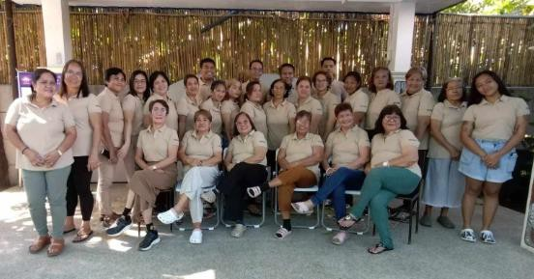
PATAMABA was founded in 1989 as a grassroots organization run and managed by women home-based workers.
It was registered at the Securities and Exchange Commission (SEC) and the Department of Labor and Employment under the Bureau of Labor Relations as a national organization of informal workers.
98% of the members are women and located in 10 regions, 30 provinces, with more than 300 chapters nationwide.
Our members are composed of HBWs, vendors, youth, small transport operators, small construction workers, and those working as service providers like village police, village health workers and beauticians.
According to 2022 research of Dr. Cabigen from the University of the Philippines, among the 50 million total labor force in the Philippines, 80% (40million) are workers in the informal economy. At present we only organized more than 70,000 members including our networks in Homenet Philippines.

Slide 3
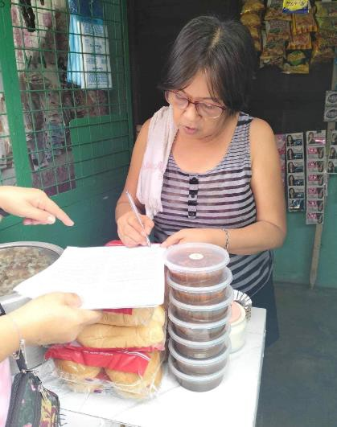
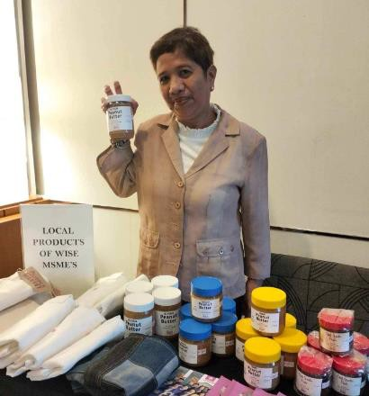
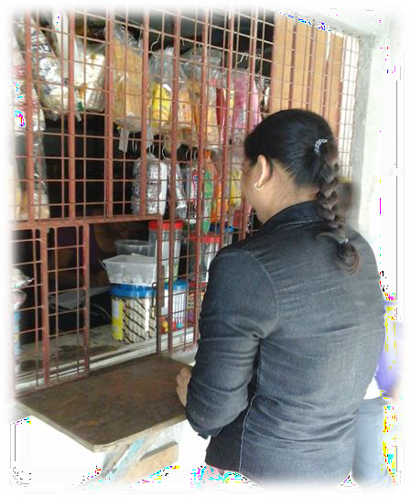
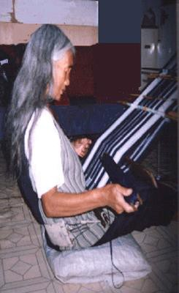
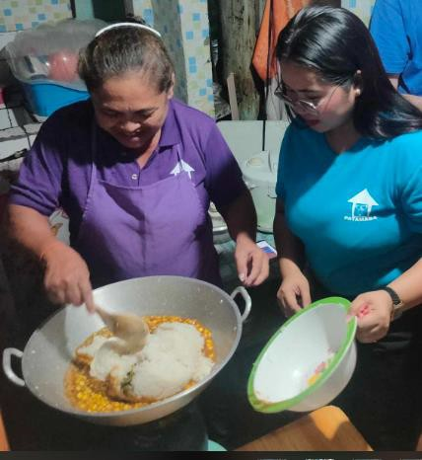
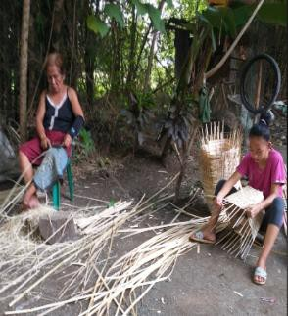
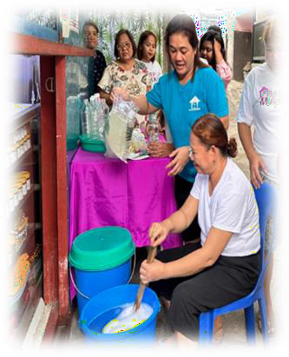

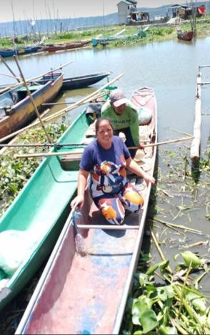
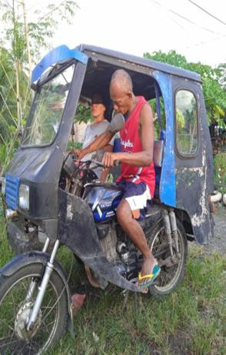
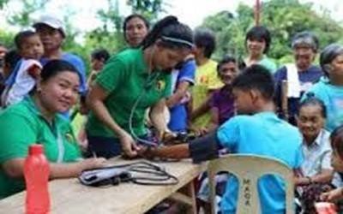
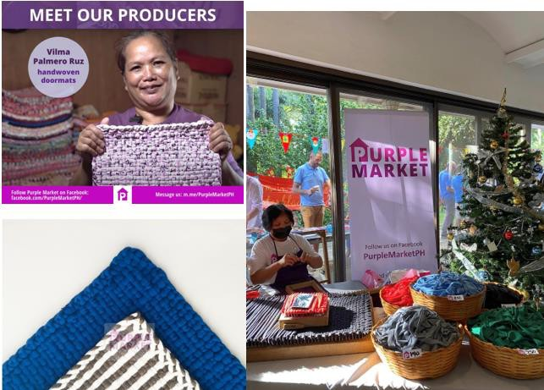
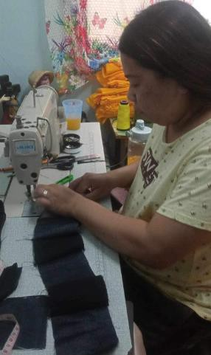
OUR MEMBERS
The Home- based workers
Doormat and rug
makers/sewers
Food processors
Bamboo weavers
Handloom weavers
Garment sewers
handicraft makers

Slide 4

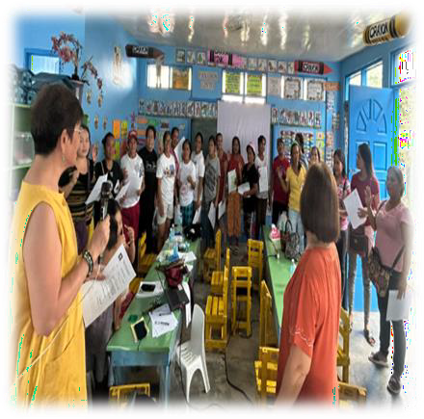
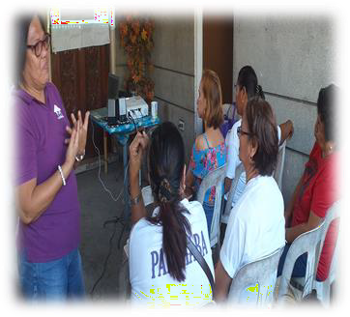
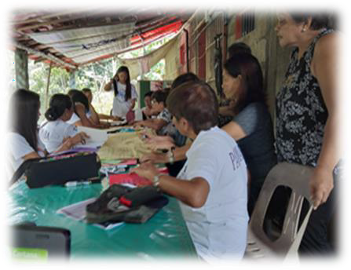
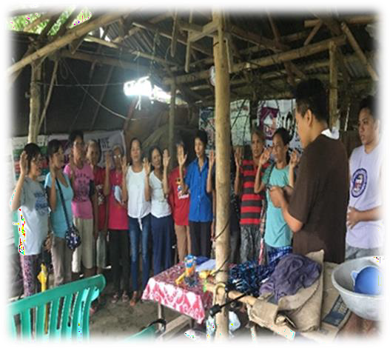
PATAMABA VISION:
Conscious and active empowerment of workers (poor, women, youth and the underprivileged) in the informal economy in building a free, equal, and prosperous society.
PATAMABA MISSION:
Advancement of the rights of workers and women in the informal economy

Slide 5
ROLE OF THE GOVERNMENT AND THE HBWS ORGANIZATIONS IN FILLING THE GAPS AND SUPPORTING THE HBWS
Under the Labor Code of the Philippines, the provision on employment of industrial home workers can be found in Book IV, Title III, Chapter IV. The implementing rules and regulations of Chapter IV Employment of Home workers was signed in 1992 and is popularly known as Department Order No. 5 of 1992.
D.O 5 affirms the right of home workers to self-organization.
But in reality, when we did a pilot testing in one of the cases regarding payment on the orders, it was not successful due to the hearing process. The time the HBWs spent coming to the hearings because they have to leave their jobs and would not have any income for the family’s daily needs, aside from the money they spent every hearing. So, its not being used.

Slide 6
THE PHILIPPINES HAS SEVERAL LAWS THAT TARGET ASPECTS OF THE
INFORMAL ECONOMY BUT THE IMPLEMENTATION IS VERY LAW.
Some examples include:
R.A. 8425 or the Social Reform and Poverty Alleviation Act is the first national legislation to recognize the informal sector, through its inclusion as one of the basic sectors. It defines workers in the informal sector as “poor individuals who operate businesses that are very small in scale and are not registered with any national government agency, and to the workers in such enterprises who sell their services in exchange for subsistence level wages or other forms of compensation.”
R.A. 11291 or the Magna Carta of the Poor (2019), which has officially established and recognized the right of marginalized sectors to a high standard of living, including decent work, access to information, social safety nets, and social insurance among others (Magna Carta of the Poor, 2019, Sections 4-6).
R.A. 9710 or the Magna Carta of Women (2009), which contains provisions on the right of marginalized women to access basic needs, decent work opportunities, protections from health hazards, as well as skills and capital (Magna Carta of Women, 2009, Sections 22-24, 27).

Slide 7
PHILIPPINE LAWS THAT TARGET ASPECTS OF THE INFORMAL ECONOMY CONT….
R.A. 9501, or the Magna Carta for Micro, Small and Medium Enterprises (MSMEs) (2008), which has institutionalized government support for MSMEs through credit allocation, simplified registration processes, public-private linkages for enterprise development, and the creation of the Small and Medium Enterprise Development Council (SMED).
R.A. 9178—known as the Act Establishing Barangay Micro Business Enterprises (BMBEs)—which encourages local government units (LGUs) to ease registration processes, as well as exempt BMBEs from income tax and coverage of the minimum wage law, provided that they still provide employees with social protections (BMBE Act, 2002, Sections 6-8).
R.A. 10361, or the Domestic Workers (Kasambahay) Law, which formalizes labor standards for household workers by requiring written contracts, as well as adherence to minimum wage and coverage for the Social Security System (SSS), PhilHealth, and Pag-IBIG insurance mechanisms. This law also criminalizes abuse and exploitation against domestic helpers, acknowledging the power imbalance and vulnerabilities they are exposed to operating within their employers’ household and under their direct authority.
R.A. 11223, known as the Universal Health Care Act (2019) ensures automatic PhilHealth enrollment for all Filipinos to access comprehensive primary, preventative, rehabilitative, curative, and palliative health services (Universal Health Care Act, 2019, Section 6)

Slide 8
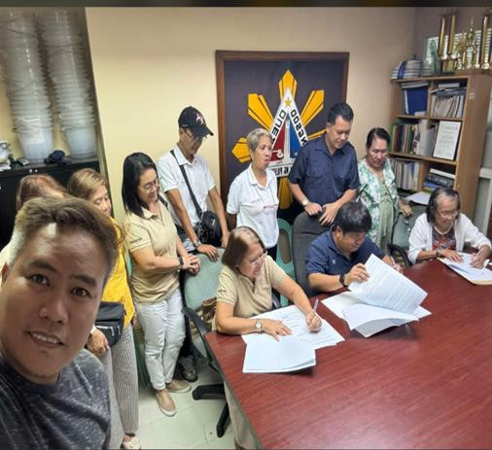
There are many legislative policies and proposals related to the issues and concerns of each sector, but the problem is the prioritization and when it became a law or a policy, the issue is about the implementation, also monitoring and evaluation on how this was implemented. Another thing, marginalized sectors are having difficulties in accessing the programs due to requirements which are not easy to provide.
In addition, the negative effects of the economic crisis are seriously felt by the HBWs-high cost of basic commodities, electric bills, water, and the like. Even the delivery of basic social services in the community such as consultation at the health center for women’s reproductive health problems is very minimal and in some cases its not for free.

Slide 9
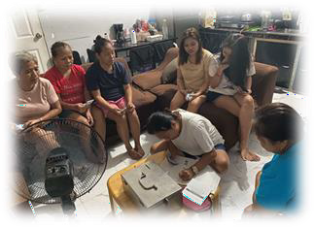
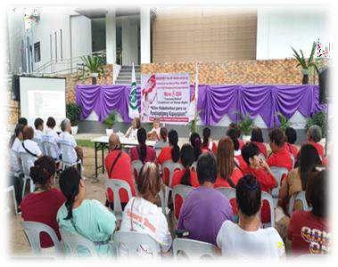
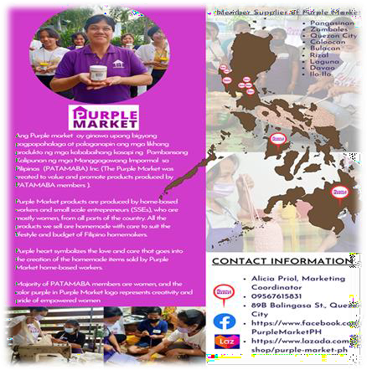
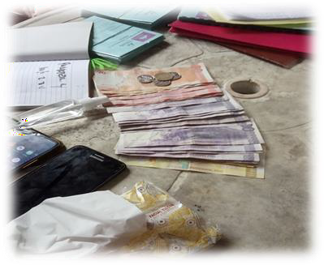
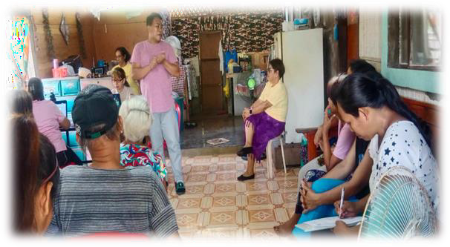
PATAMABA’S PROGRAMS TO EMPOWER HOME-BASED WORKERS
Participation in the management and strengthening of the organization thru organizing, networking and coalition building (local, national and international)
Services for the enhancement and development of personal skills, awareness raising, education and training including training on alternative livelihoods and capacity development, gender, health and reproductive rights
Livelihood assistance
Purple Market an online and physical store for promoting HBWs products
Village Savings and Loan Associations (VSLAs) a group enterprise introduce by our organization so that they will not get loan from other micro financing institution
Social Solidarity Economy (SSE)
Business and market development through CEFE – Community-based Economies through the Formation of Entrepreneurs

Slide 10
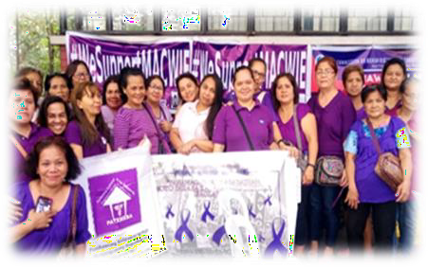
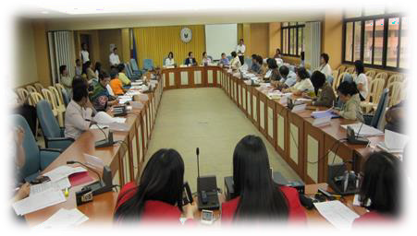
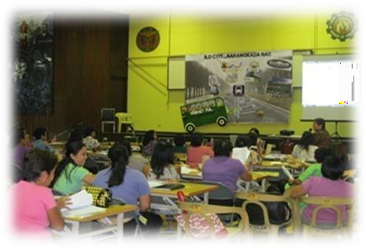
D. Lobbying, Advocacy and Paralegal Work
Building relationships with the GOs, NGOs, LGUs, Int’l. agencies, academe, TUs, cooperatives
Advocating for the ratification of ILC 177 which until now this convention is not yet ratified. Then came the recommendation 204, the formalization of informal workers and this is ongoing process especially with the DOLE and ILO Manila together with the informal sectors group and other networks and alliances.
Through the formation of a national network of homebased workers in the Philippines (HOMENETPHIL composed of 32 organizations of HBWs and other workers in the informal economy), we drafted a bill together with our partners from the academe, policy makers called Magna Carta of Workers in the Informal Economy (MACWIE)Bill. But sad to say, it’s been 2 decades now but still we are advocating for its passage. This bill is an act providing for a Magna Carta of workers, enterprises and organizations in the informal economy and institutionalizing mechanisms for transitioning to formal economy.
Localization of the bill (local ordinances) is also one of the initiatives to have policy on informal workers at least within the community level

Slide 11
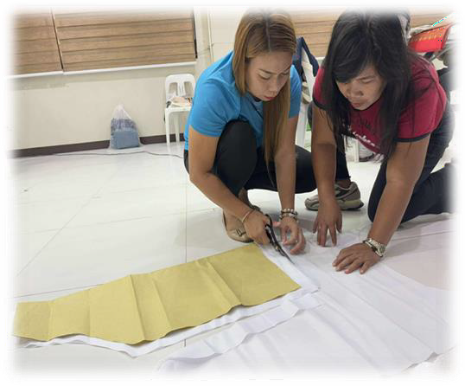
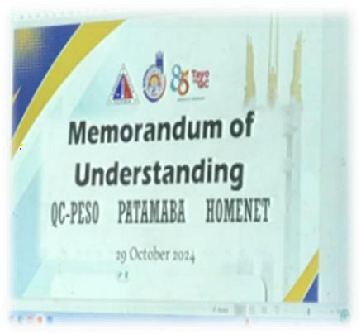
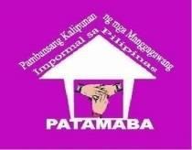
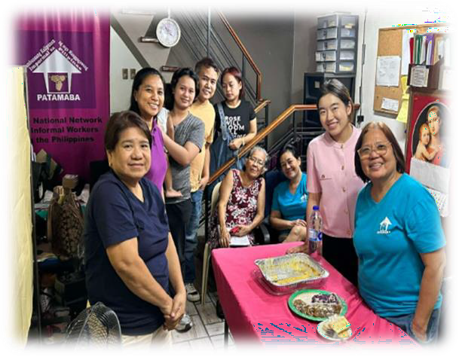


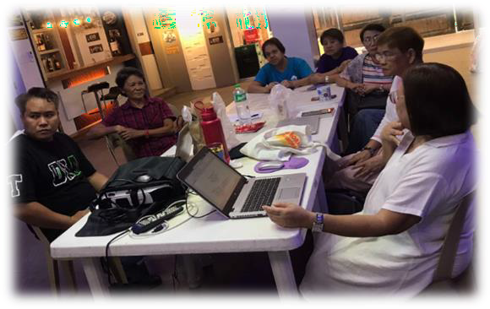
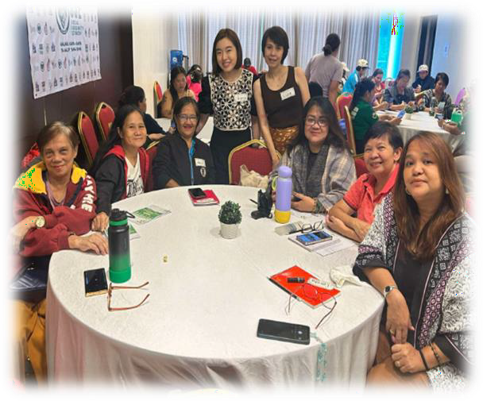
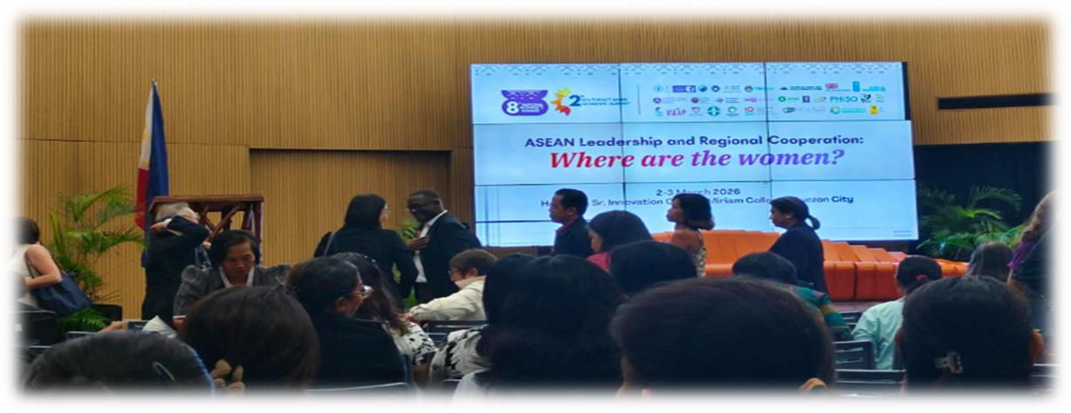
THANK YOU FOR LISTENING

