Slide 1
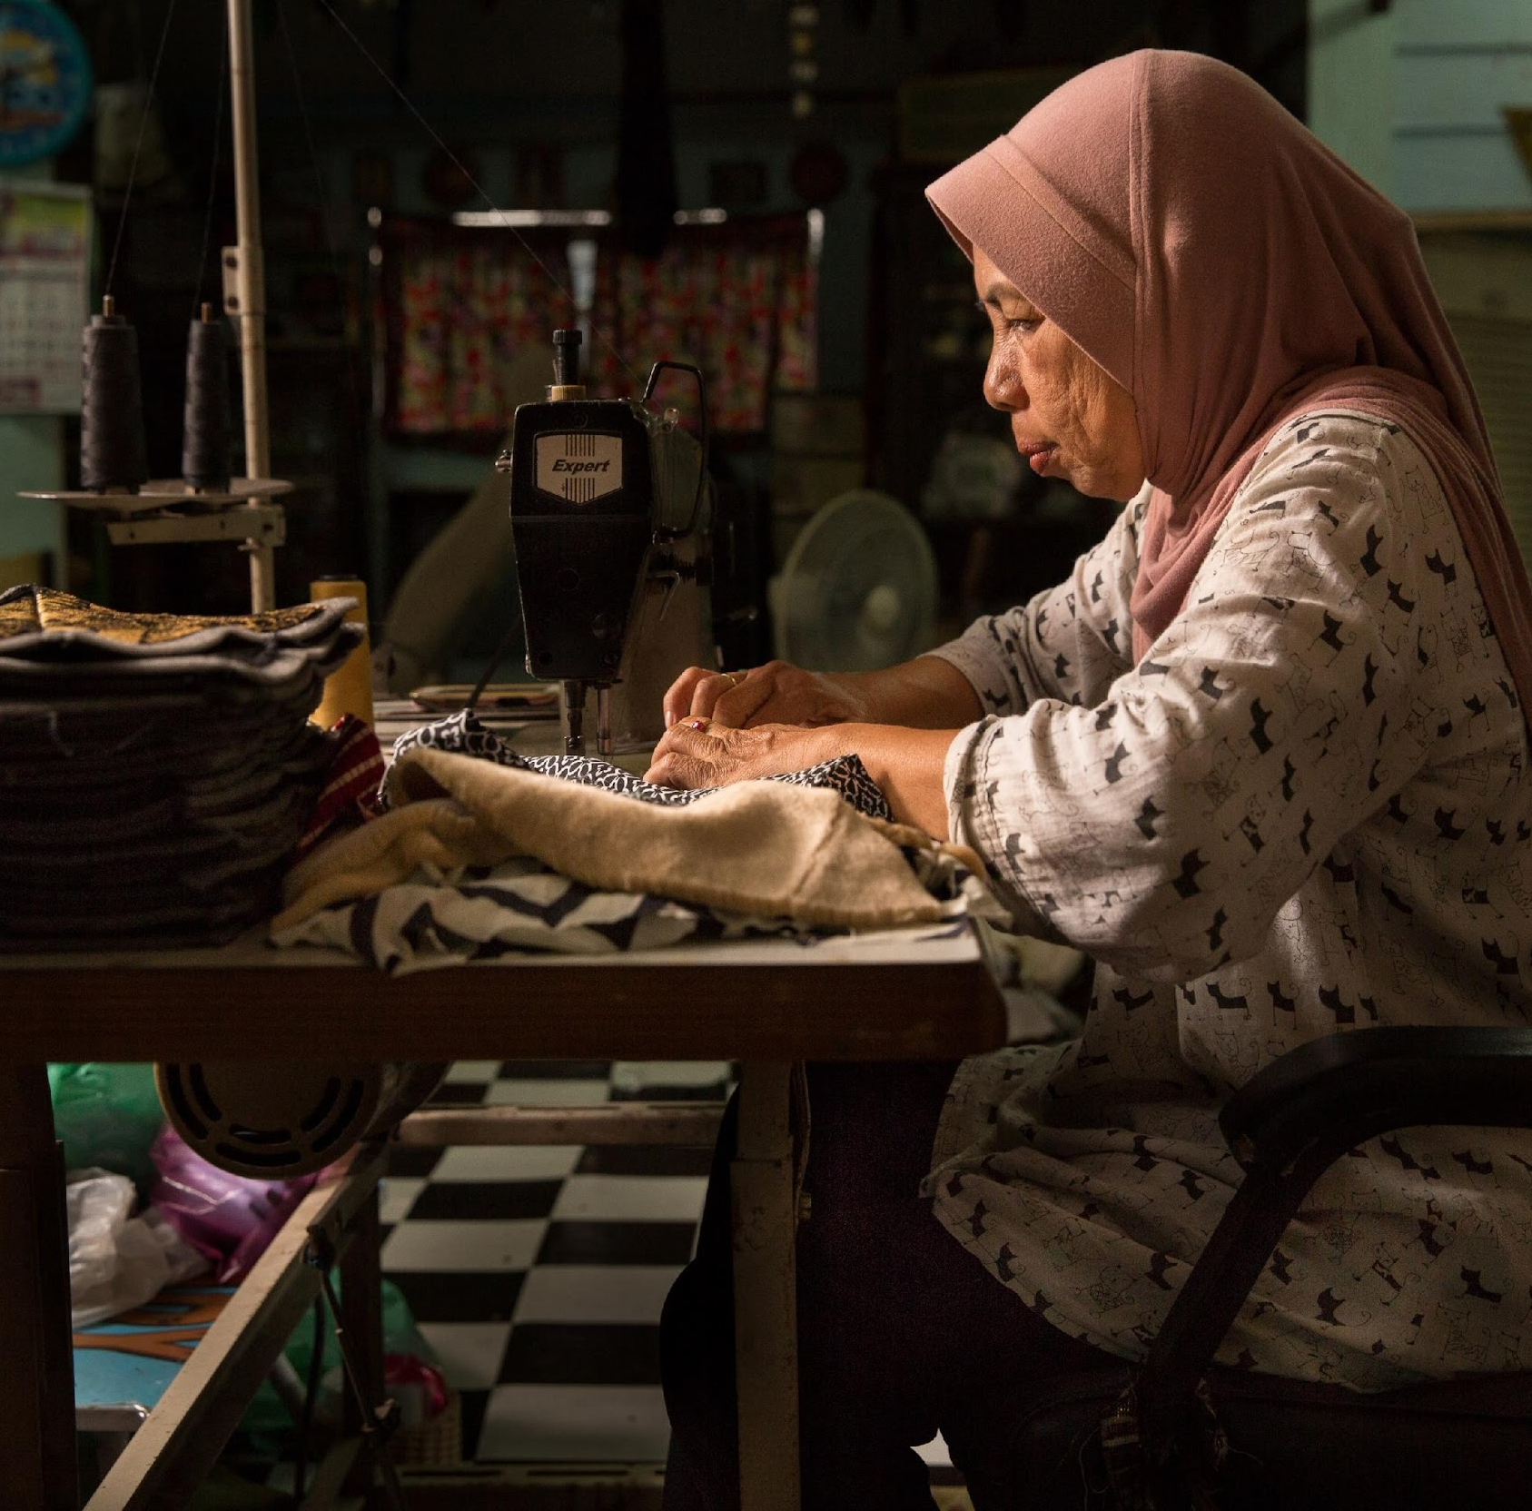

Invisible in the Law: Why Home-Based Workers Lack Legal Protection
19 March 2026
Krithika A Dinesh

Slide 2
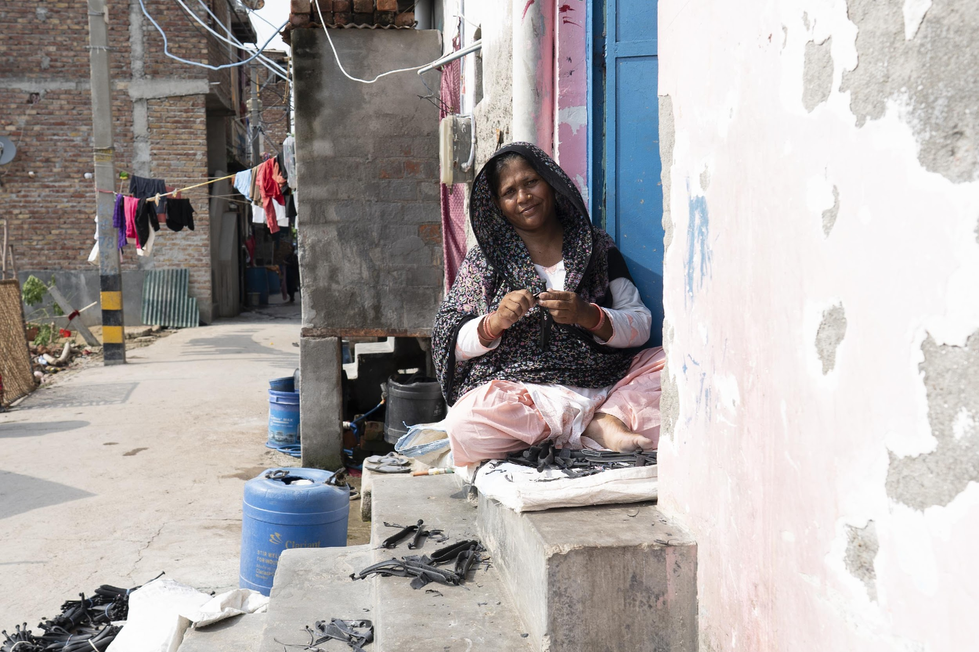
I. WHO ARE HOME-BASED WORKERS?
Photographed on 24th July 2025, Ruhani Kaur

Slide 3
Who are home-based workers?
Self-employed or own account “home-based workers” are those who design, produce, and market their products to the local and global markets, and who have direct access to raw materials.
Responsible for sourcing, production, bringing the good or service to the market for sale and pricing.
Sub-contracted Home-based Workers, also known as “homeworkers” or “piece-rate workers”, who are provided work through a series of subcontractors, provided with raw material and instructions, and upon
completion of work are paid on a piece rate basis.
C177 defines homework as work:
done in premises of their choice, anywhere other than the workplace of the employer
or remuneration
that results in a product or service as specified by the employer (irrespective of who provides equipment, materials or other inputs)
260 million home-based workers in 2019 (ILO estimates), forming 7.9 of global employment.
Work that is carried out in one’s own home or near it.

Slide 4
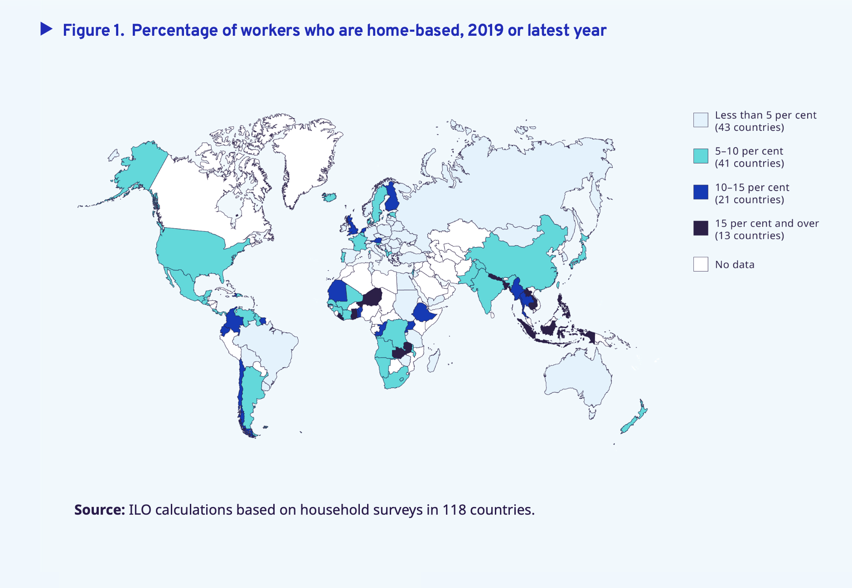
Percentage of workers who are home-based
ILO calculations based on household surveys in 118 countries, 2019 or latest year, ILO 2023

Slide 5
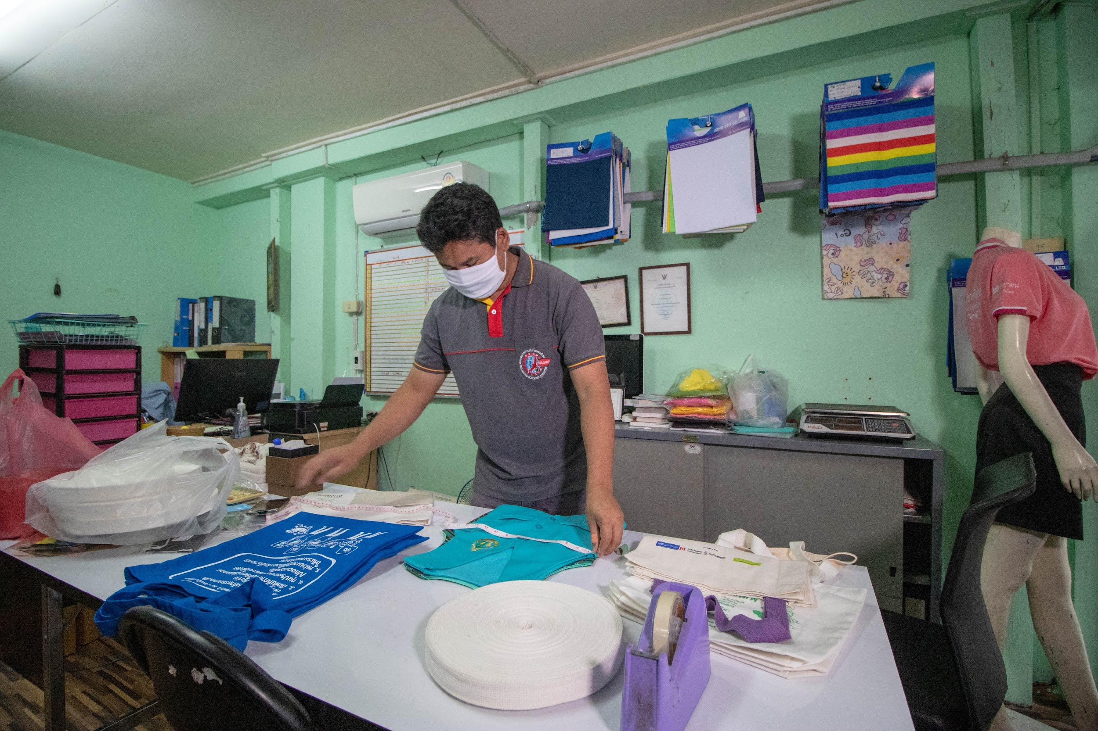
II. LEGAL EXCLUSIONS
Photo by Pattarapon Virat

Slide 6

The Architecture of Labor Law
Labour Law
1
2
Employees Permanent, full-time, work on the premises and have a direct contractual relationship with employer
Independent Contractors Assumed they are just providing services and are independent people who can decide their own contractual terms
Freedom of Association and Collective Bargaining; organising rights right to strike, collective bargaining agreements
Certain contractual terms about wages, hours, leave, severance pay etc.

Slide 7
Impact of Legal Exclusion
Recognition,
Employee
OR
Independent Contractor
leads to…
Organization,
Union with organizational rights and right to strike
Association
leads to…
Collective
representation,
Recognised social partner
Collective Bargaining
Excluded from social dialogue
Incentive for negotiation?
leads to…
Improved
working
conditions
Inclusive policy
reforms
Collective Agreements
Inappropriate
reforms?
No access to labour dispute resolution

Slide 8
In Law and Practice
Recognition
13 ratifications of C177
Specific inclusion in labour laws: Philippines, Bulgaria
Specific legislations: Thailand, Pakistan
Supply chain legislation
Collective representation
Trade unions
Other forms of organizing: community based organizations, membership based organizations, associations
Recognition
Not considered “workers”
Difficult for inclusion in labour laws
Specific laws: still does not give access to all provisions.
Collective representation
Legal recognition as trade unions or representative bodies difficult
CoBs practically non-existent
Some representation in committees

Slide 9
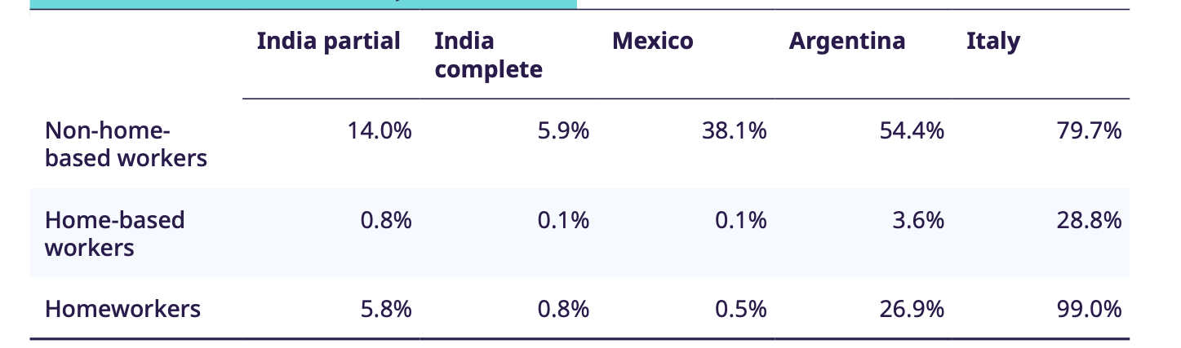
In Law and Practice
Access to Social Protection in select countries of HBW
Working conditions
Mostly verbal agreements
Wage setting processes
No set hours, leaves
Some social protection
Occupational health and safety
Protection against sexual harassment at workplace
Access to remedies
Labour law mechanisms
Lack specific dispute mechanisms
Difficulty in access, intimidation, threat of work withdrawal
Enforcement mechanisms
In cases of inclusion, still very weak

Slide 10
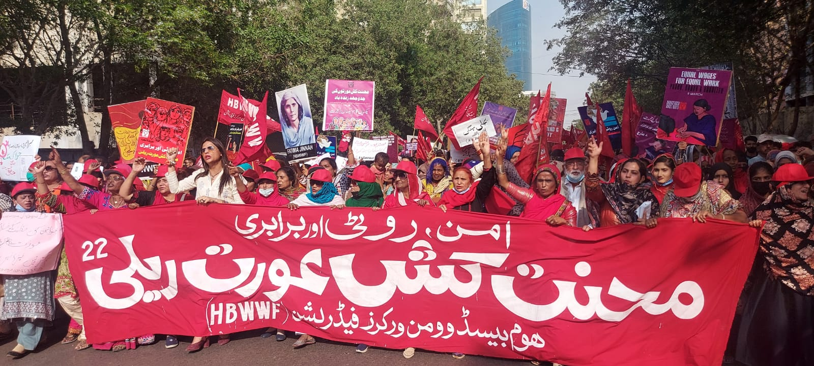
III. BUILDING AN ENABLING LEGAL FRAMEWORK

Slide 11
III. Building an Enabling Legal Framework
Inclusion in labour laws
extends work and working conditions (wage-setting, OHS, social security)
extends sexual harassment at workplace
organising and collective bargaining rights
extends homes for inspection
accessible dispute redressal mechanisms
enforcement mechanisms
Ensuring enforcement
transparency across supply chains
right to information
right of representation
Notes:
ensuring wage setting, protection against sexual harassment, dispute mechanism, extends homes for inspection
Even labour laws are in some ways insufficient to tackle the concerns of HBWs-in terms of access to infrastructure
Recognize home as workplace and informal settlements as sites of economic activity
How to give HBWs spaces to make participatory laws, policies and plans that will give rights to housing, infrastructure and transport
How to integrate recognition of homes as workplaces (zoning, Eg Mai bhi dilli ) in master, city, town plans.
How to ensure access to markets, credit, training?
How to develop creative, accessible dispute redressal mechanisms for HBWs?

Slide 12
III. Building an Enabling Legal Framework (contd)
Access to legal empowerment: building legal awareness to know, use and shape laws
Access to infrastructure: better housing, access to water, sanitation, transport
Recognize home as workplace and informal settlements as sites of economic activity: How do we integrate recognition of homes as workplaces in zoning laws such as master, city, town plans? (Eg Mai bhi dilli campaign)
Access to markets, credit, training

Slide 13
Thank you for your time and attention!

