Slide 1
CAPACITY BUILDING STRATEGY FOR HOME-BASED WORKERS IN VIET NAM
Presented by: Mr. Le Van Son
Country Coordinator - Home-Net Viet Nam
19 March 2026

Slide 2

Who are Home-based Workers in Viet Nam?
Not yet recognized by current labor law 2019
Work from home or nearby (rooted by caregiving roles and unpaid work)
Majority working in the informal sector and low income
Often women, migrants, near-poor people, or ethnic minorities
Limited social protection access (e.g health and social insurance, maternity care)
👉 Home-based workers are essential but often invisible

Slide 3
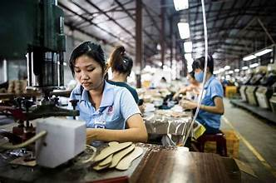
KEY CHALLENGES FACING BY HOME-BASED WORKER IN VIET NAM
Lack of legal recognition
Limited access to: Markets, finance, training
Low and unstable income
Gender inequality (majority are women)
Climate vulnerability
👉 Challenges reduce resilience and opportunities

Slide 4
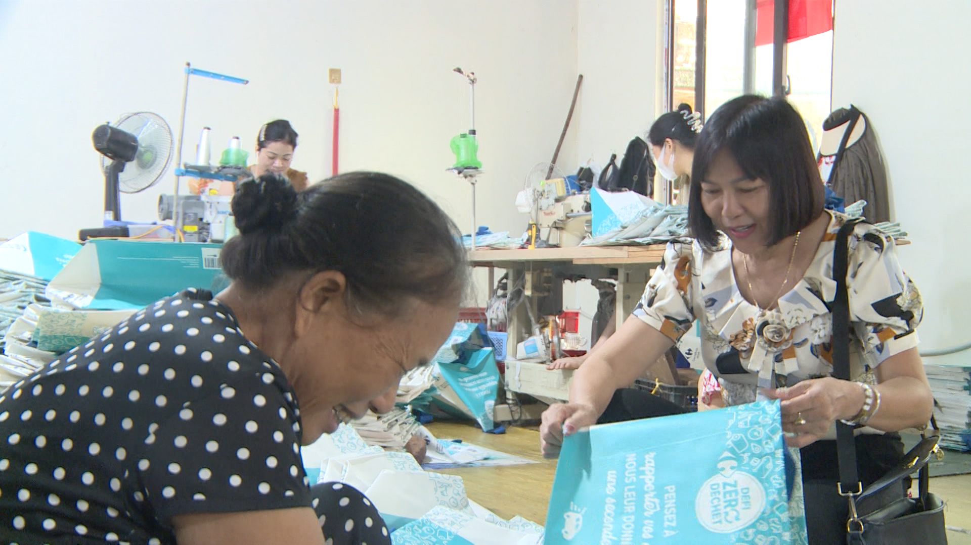
WHY CAPACITY BUILDING IS MATTER
Improves skills and productivity
Builds confidence and voice in public space and social protection at least
Enhances access to economic opportunities
Strengthens resilience to climate risks
👉 Informed and skilled HBWs can better protect their rights and improve livelihoods

Slide 5
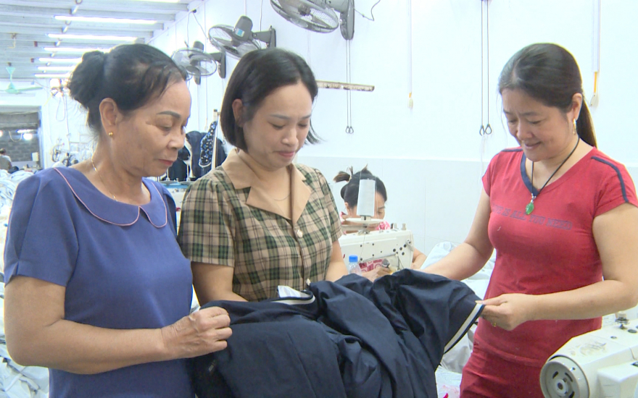
Key area of work: Research & Mapping HBWs in Vietnam
Collect data on: sectors, income, working conditions
Explore gender dimensions and vulnerabilities
Understand working condition and capacity needs
Identify key challenges and gaps in recognition
Review international experience in supporting and organizing HBWs.
👉 Strong evidence and organized groups are the foundation for recognition

Slide 6
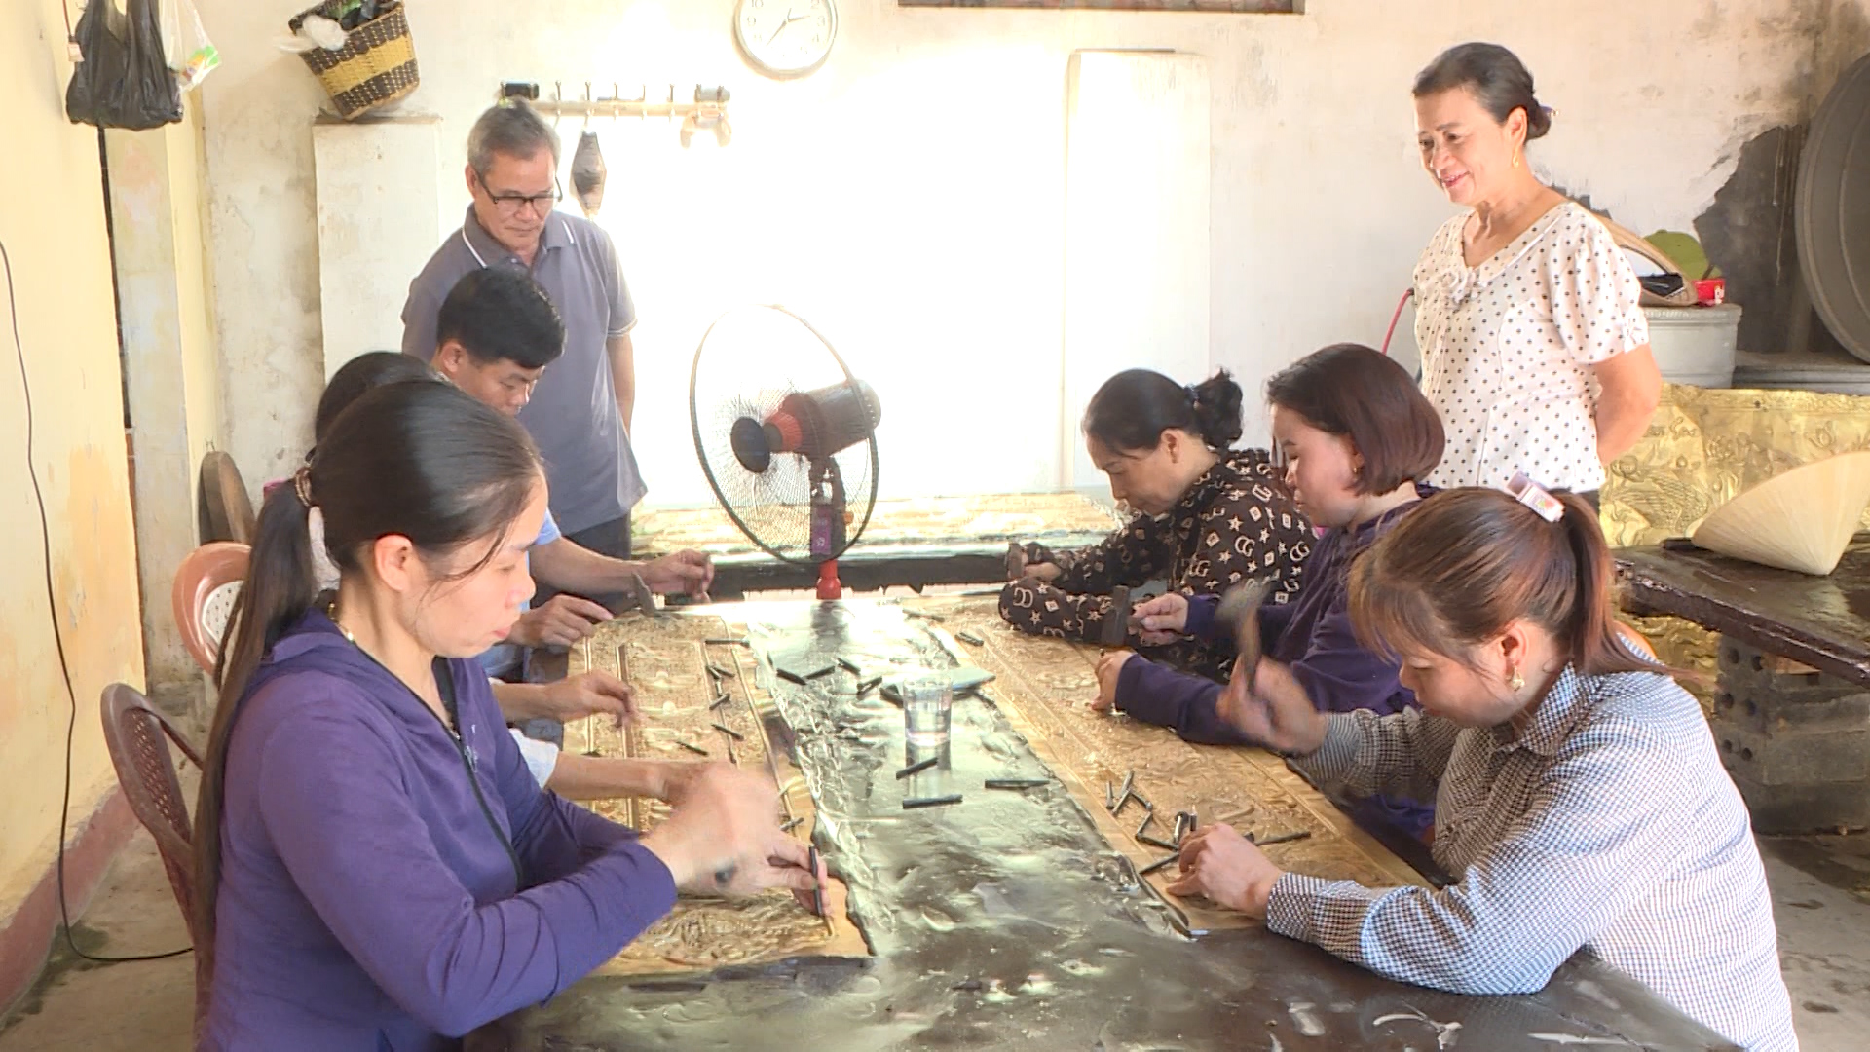
KEY AREA OF WORK: ESTABLISH AND MAINTAIN GROUP OF HOME-BASED WORKERS
Set up 02 pilot groups of HBWs in Ha Noi and Ho Chi Minh city (by GFCD and SDRC)
Create safe spaces for sharing experiences (market access, social and health insurance)
Peer learning on specific topic (labor rights, working condition, social and health insurance
Collective voice to access basic service (education, housing, health)
👉 Strong evidence and organized groups are the foundation for recognition

Slide 7
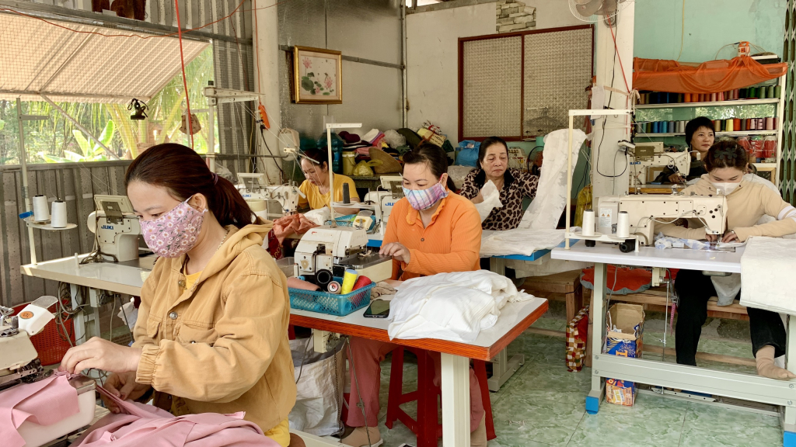
KEY AREA OF WORK: TRAINING AND LEARNING FOR GROUPS MEMBERS
Legal awareness raising (e.g. labor laws and rights, social protection policies; rights and responsibilities of HBWs.
Skills development: Communication, self-advocacy and negotiation with buyers/employers
Promoting access to service: financial and livelihood skills
👉 Informed and skilled HBWs can better protect their rights and improve livelihoods

Slide 8
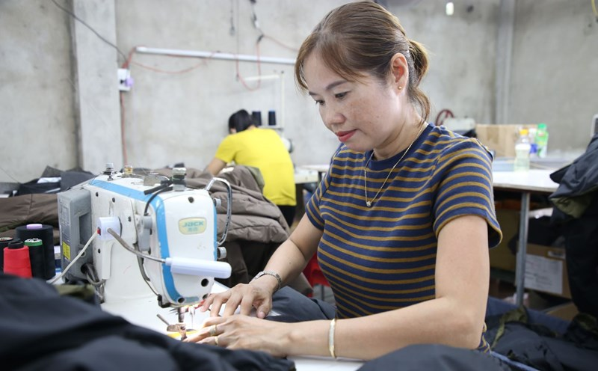
KEY AREA OF WORK: COMMUNICATION & ADVOCACY THROUGH DIGITAL PLATFORMS
Raise awareness on: Rights, Challenges and contributions of HBWs
Connect HBWs across locations
Promote peer exchange and solidarity
Increase visibility to: Public and Policymakers
👉 Visibility drives recognition, and recognition leads to better support

Slide 9
WHY HOMENET VIETNAM TAKING THIS ROLE
Build and strengthen HBW networks: enhance collective voice, peer learning, and mutual support.
Enhance capacity and skills for HBWs: legal rights, labor regulations, and essential soft skills such as communication and negotiation is critical.
Leverage digital communication for visibility: use digital platforms, such as social media, should be used to amplify the voices and stories of HBWs and raise public awareness and increase visibility of their contributions to the economy.
Promote multi-stakeholder collaboration: Stronger collaboration with government agencies, civil society organizations, and the private sector to create an enabling environment for HBWs and improve access to resources and support system.

Slide 10


