Slide 1
Webinar on ILO C177 - Case of Thailand
Suntaree H. Saeng-ging, HomeNet Thailand
July 28th 2023

Slide 2
Thailand Country Context
National Labour Survey 2022 by National Statistic Office
Total population: 66.1 Millions
Labour Force: 40.1 Millions
Employed workers 39.6 Millions
Workers in Formal Employment 19.4 Millions (49.0%)
Workers in Informal Employment 20.2 Millions ( 51.0 %) :
Women: 9.0 Millions Men: 11.2 Millions
…
…

Slide 3
Thailand Country Context
Problem of Definition
Formal Employment refers to employed persons who are protected or have social security from work.
1) Officer government, permanent employees of central government official,
government authority and local government.
2) State employees.
3) Employees of the Welfare Fund under the Private School Act 2007.
4) Employees of foreign governments or international organizations.
5) Employees who are protected by labor laws.
6)Employed persons who are insure (article 33, 39 and 40) with the Social Security Office.
Informal Employment refers to employed persons who are not protected or have no social security from work like formal employment.
…
…

Slide 4
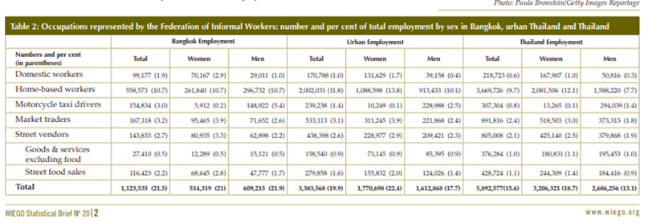
Thailand Country Context

Slide 5
C177 and
Home Workers Protection Act B.E.2553 (2010)
Since political reform in 1997, the Thai constitution has allowed 50,000 Thai citizens to sign up for submission of the law to Council’s consideration.
HNT: HBWs leaders, Labour Lawyers and organizers, by learning the principles of C177, draft and advocate on Home Workers Protection Act.
2005-2007, HNT work with the 3 significant political parties. At last, both governance and opposite parties submitted our draft and appointed 3 HNT representatives to be members of the consideration commission. The commission considered and compared of the draft of HNT and Ministry of Labour.
Whole consideration process take almost 2 years time and passed by the parliament in November 2010.

Slide 6
Salient Features of
Home Workers Protection Act
Guarantee the equal pay for equal work: if the home work is of the same nature and quality and equal quantity the remuneration for the home worker shall not be less than that stipulated by the labour protection law.
On Safety: It is forbidden for an hirer to carry out hazardous works materials, tools or machines, extreme heat or coldness etc. The hirer shall give warning notice informing home workers of the danger and hazard. The hirer shall be responsible for medical expenses, rehabilitation expenses and funeral expenses in case where the home worker met with danger, ill, disabled or death.
Homework protection Committee: with 3 members who are representatives of home workers elected from among themselves
…

Slide 7
Challenges / Gaps
The Ministry of Labour doesn’t have the name list of hirers and homeworkers’ groups for active implementation. To register in the system is voluntary.
Homeworkers do not have the power to negotiate with the hirers. They afraid of losing jobs and income.
The ones who have to raise any violations or file complaints are the homeworkers themselves. According to the law, a third party is not permitted to fulfill this role.
…

Slide 8
Resources
Home Workers Protection Act B.E.2553 (2010)
ILO website: https://www.ilo.org/dyn/natlex/natlex4.detail?p_lang=en&p_isn=93545
PDF: https://www.ilo.org/dyn/natlex/docs/ELECTRONIC/93545/109400/F-1826987314/THA93545%20Eng.pdf
Informal Workers in Urban Thailand: A Statistical Snapshot
https://www.wiego.org/publications/informal-workers-urban-thailand-statistical-snapshot
…

Slide 9
…
THANK YOU

