Slide 1
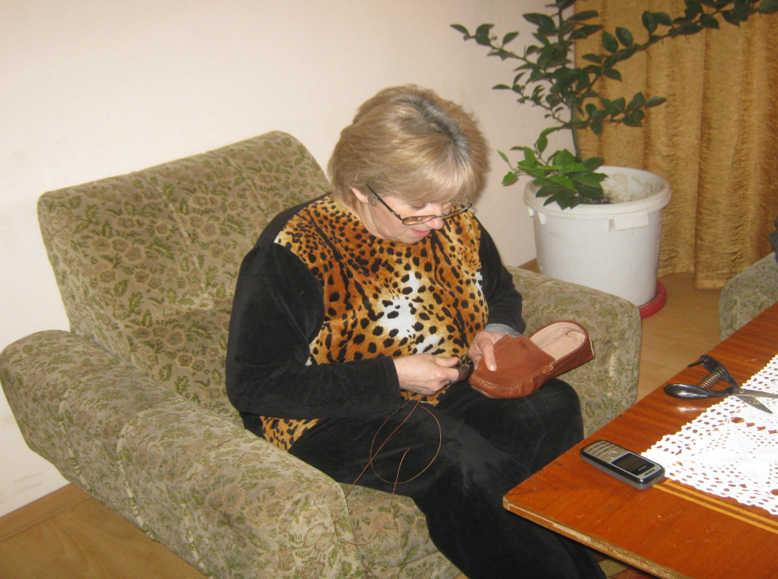
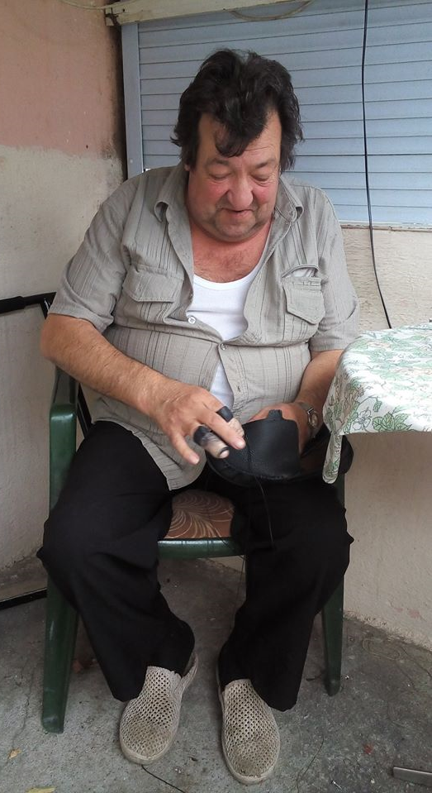
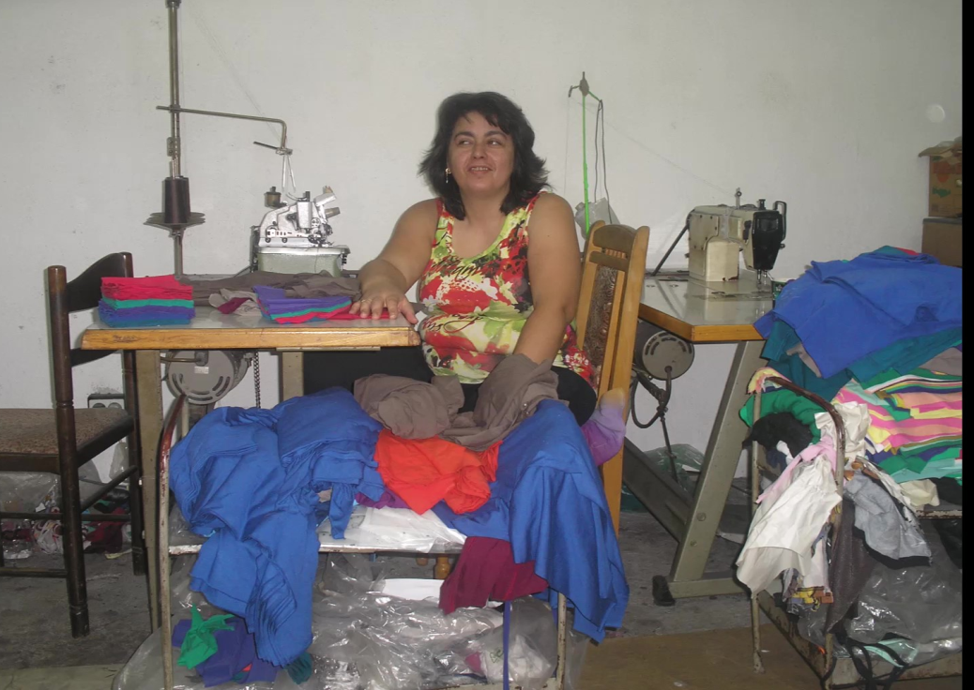
WEBINAR ON ILO C177 - CASE OF BULGARIA
A family of shoemakers - they sew for Italian shoe companies
Home seamstress from Southwest Bulgaria - sews for Hugo Boss, Max Mara
Violeta Zlateva

Slide 2
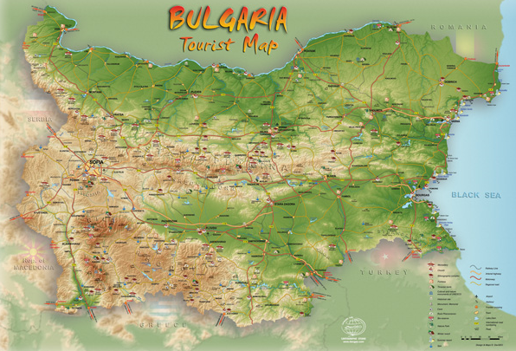
BULGARIA
Bulgaria is a Balkan nation with diverse
terrain encompassing Black Sea
coastline, a mountainous interior and
rivers, including the Danube. A cultural
melting pot with Greek, Slavic, Ottoman,
and Persian influences, it Has a rich
Heritage of Traditional dance,
Music,costumes, and crafts. At the foot of
Domed Vitosha mountain is its capital
city, Sofia, dating to the 5th century B.C.
Capital: Sofia
Official language: Bulgarian
Population: 6.878 million (2021) World Ban
Dialing code: +359
Government: Unitary state, Parliamentary
republic
President: Rumen Radev
Prime minister: Nikolai Denkov

Slide 3
The Trade Union of Self-employed and Informal Workers (UNITY)^{[1]} was created in July 2014 and is a registered and recognised trade union in Bulgaria. UNITY (TUSIW “Edinstvo”)’s founding member was the Association of Homeworkers in Bulgaria, which was also the driving force behind Bulgaria’s ratification of Convention 177 on Homework together with allied trade unions
CONTEXT
The Association of home workers – BULGARIA – Beginning – 2000 and formed - 2002 ;
Structures: Built 15 centers in the country with 22 local coordinators and 42 000 membership. All coordinators form the Coordination Council, which represents home workers at national level
The Association’s major activity is to organize events which provide people with greater information regarding home-based labor, as well as help better inform home-based workers themselves. It also strives for providing sources to finance the acquiring or upgrading of the qualification of unemployed people and/or home-based manufacturers.
Home-based workers employed by Bulgarian and foreign employers are employed in light industry
Self-employed home workers make various products in the fields of: jewelry, souvenirs, agricultural produce, food, clothing, fabrics, embroidery, fine art, wood carving, pottery and other crafts
Membership dues: Constitution stipulates member dues are 1% of the minimum wage. There are exceptions when the homeworkers have difficulties in paying this fee, so they pay a smaller amount- but they still pay.
The paid dues are spent in the regional structures. The coordinators themselves pay their dues to the national office in Sofia.

Slide 4
STATUS DOCUMENT ILO C177
The ILO defines home workers as people who work from their homes or other places of their choice, other than the workplace, for remuneration;
There are two main categories of home-based work recognized in ILO conventions and literature: dependent and self-employed;
"Dependent" workers produce a product or service, as specified by the employer/contractor;
Work for one's own account (self-employed) is carried out independently or with one or more partners, without a long-term commitment to a contractor or employer;
Article 1 of Convention 177 defines home work as follows:The term "home work" means work performed by a person who will be called a home worker(i) at her home or at other premises of her choice, other than the employer's workplace;ii) for remuneration;(iii) resulting in a product or service specified by the employer, regardless of who provides the equipment, materials or other materials used
…

Slide 5
MAIN FEATURES POLICIES
From 2002 - 2007, the Association of Home Workers in partnership with trade unions, employers' organizations, the National Statistical Union and the National Insurance Institute under the leadership of the Ministry of Labor and Social Policy held regular meetings on the problems of home work in Bulgaria;
2007 The Council of Ministers decided to ratify ILO Convention 177 and it was submitted to the Parliament for a vote;
Given the government crisis and the creation of a regular government in 2009, the ratification is voted on by the National Assembly;
Decision of the National Council for Tripartite Cooperation of October 2009 to adopt anti-crisis measures, one of which was the achievement of a bilateral agreement between them on the regulation of home work;
Decision of the Council of Ministers of June 2009 on "Bulgarian" Path "to achieve better flexibility and security on the labor market 2009-2011" and HAVE AGREED AS FOLLOWS:
Settlement and regulation of homework within the meaning of ILO Convention 177

Slide 6
PROBLEMS/DISADVANTAGES
On 23 October 2014, Unity sent a letter to the ILO registering the following concerns:
1. Despite amendments to Bulgaria’s Labour Code, there is no national policy on homework in Bulgaria (Art 3)
2.UNITY approached the Ministry of Labour and Social Policy government for discussions on a homeworker policy and was denied ‘consultation rights’ as ‘an organisation that is concerned with homework’ (Art 3).
3.The Ministry of Labour and Social Policy insists that homeworkers are independent contractors and fall outside the scope of C177 and of the Labour Code, despite their receiving orders from intermediaries, workshops and factories.
4. Piece rates paid to homeworkers fall well below the minimum wage.
The Committee requests the Government to provide detailed information concerning the measures adopted or envisaged to improve the situation of homeworkers, and to identify the employers’ and workers’ organizations that have been consulted with regard to the development, implementation and review of such measures.

Slide 7
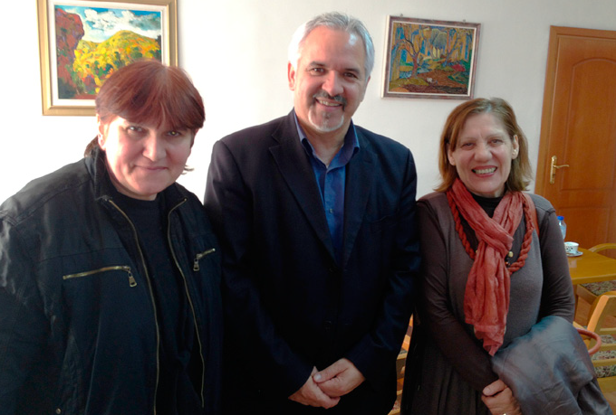
RESOURCES
Mapping of home based work (2002-2003; 2006-2007; 2009-2010 and 2011-2012 )
Training of 28 coordinators
Regular exhibitions - local, national and international;
Organization and participation in local, national, Balkan and international seminars;
Training of more than 420 home workers;
Providing jobs for 1500 Employment contract outworkers;
Open, with the help of local authorities, 6 shops for selling of home based production;
We have been working for 5 years now on creating co-operatives in the rural areas: - Vegetable Growers’ cooperatives; - Greenhouse Growers’ cooperatives; - Dairy Producers’ cooperatives
Holding of conferences, seminars, festivals in the rural areas instead of the cities;
Creating a HomeNet Eastern Europe and Central Asia network
Organizing training and qualification of self-employed workers;
Preparation of legal regimes for self-employed home-based workers
…
The cooperation between the municipality and the Association in Petrich means that they receive considerable support from the local municipality

Slide 8
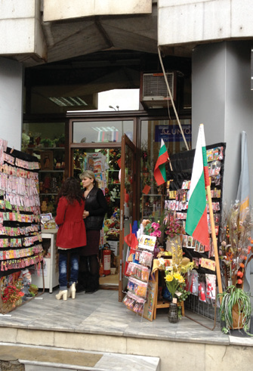
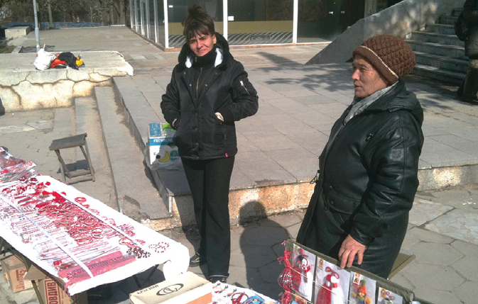
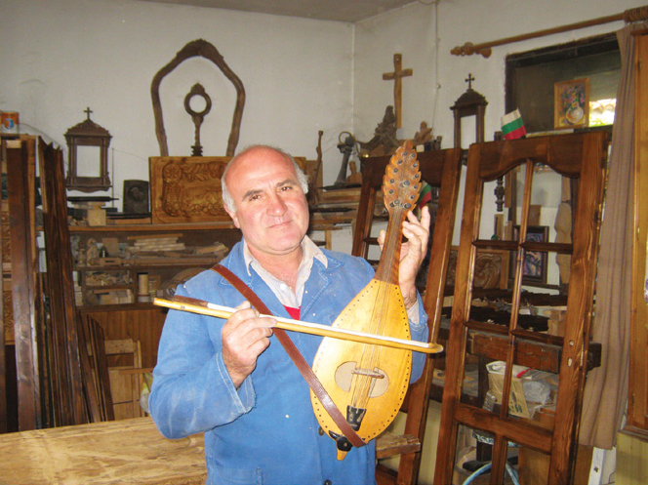
ILO Convention 177 of 1996 does not protect the work of self-employed home-based workers. And their number after 2007 in Bulgaria increased compared to home workers working with an employer/contractor
…
The fight for decent and legal work for the home-based worker continues
Thank you!

