Slide 1
ILO, ILC, Conventions and Recommendations

Slide 2
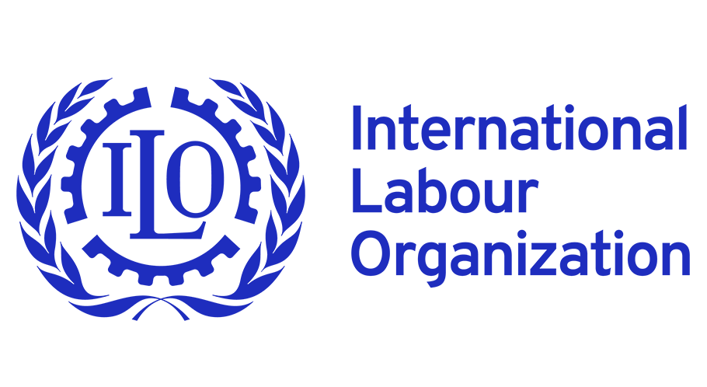
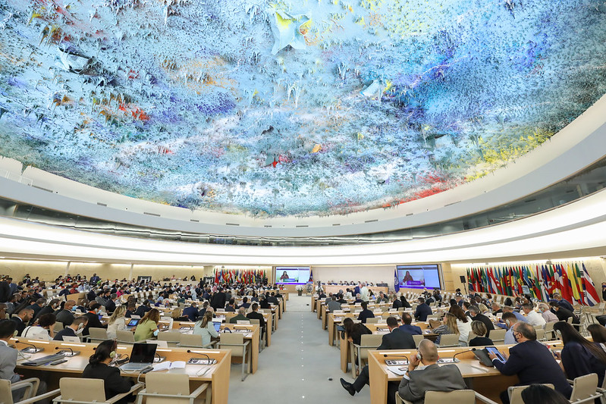
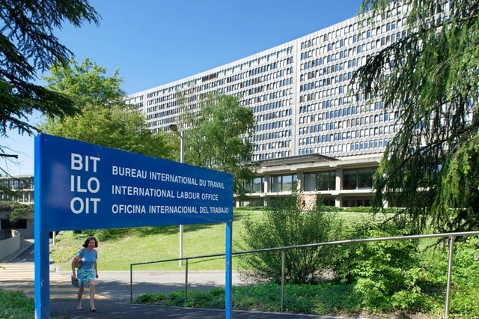
What does ILO stand for?
Founded in 1919 and headquartered in Geneva
Specialized agency of the United Nations
Focuses on promoting social justice and decent work worldwide.
Notes:
ILO stands for International Labour Organization, a specialized agency of the United Nations that focuses on promoting social justice and decent work worldwide.

Slide 3
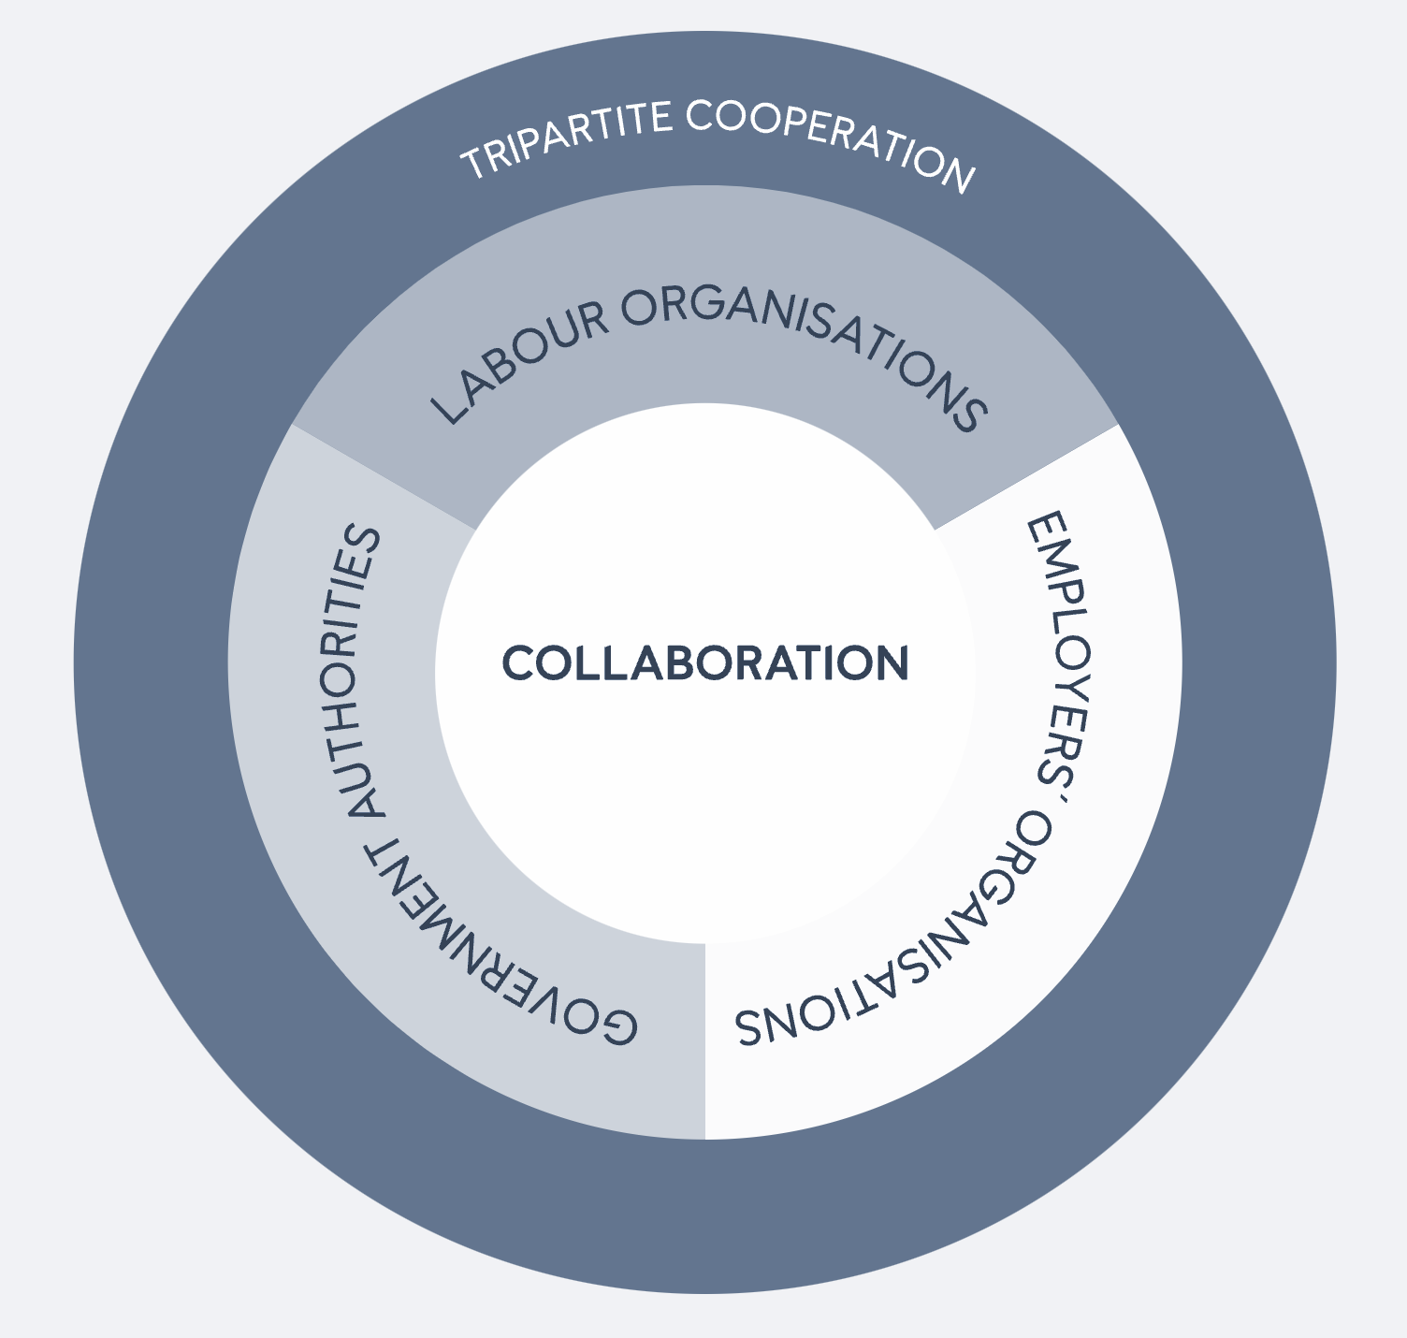
What is unique about the ILO compared to other UN agencies?
It is a worldwide tripartite organisation:
workers + employers + governments together on equal terms to develop and oversee international labour standards.
Notes:
Founded in 1919 and headquartered in Geneva, the ILO is the only worldwide tripartite organisation in which workers’ and employers' organisations are represented on equal terms with governments to develop and oversee international labour standards.
Founded in 1919 and headquartered in Geneva, the ILO is the only worldwide tripartite organisation in which workers’ and employers' organisations are represented on equal terms with governments to develop and oversee international labour standards.

Slide 4
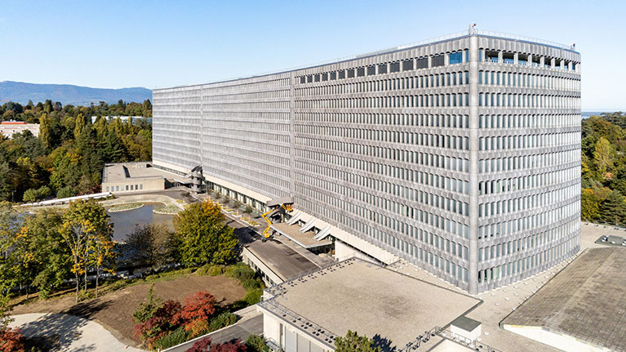
What is the main purpose of the ILO?
ILO's primary task is to set labour standards and to promote 'decent work’ so as to improve the livelihoods of working people everywhere.
Notes:
ILO's primary task is to set labour standards and to promote 'decent work’ so as to improve the livelihoods of working people everywhere. This is done primarily through the International Labour Conference (ILC), which is held once a year in Geneva.

Slide 5
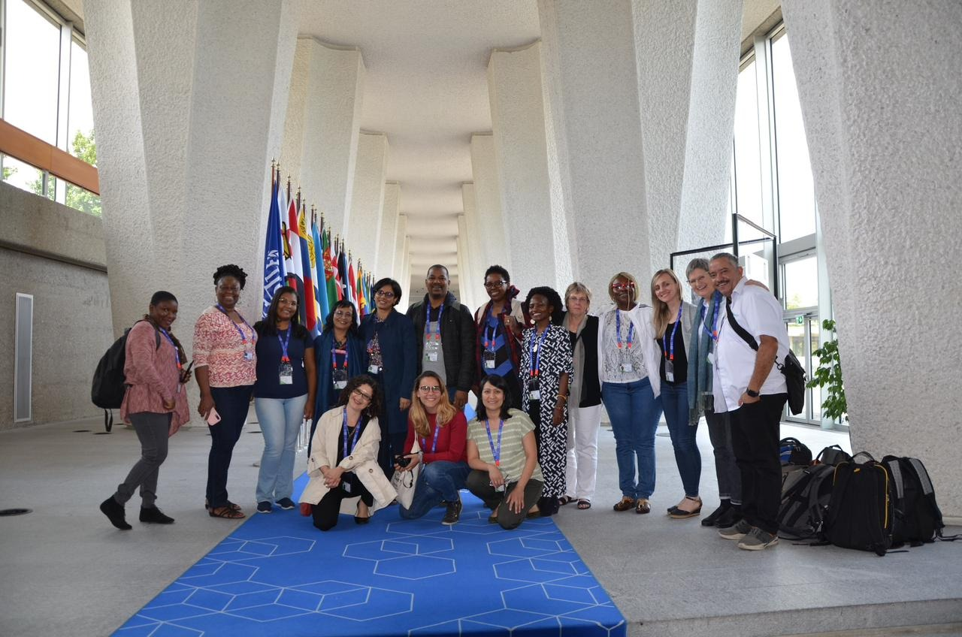
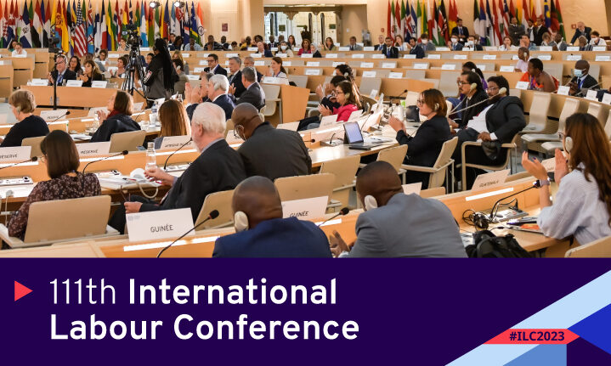
What is the International Labour Conference (ILC)?
Annual gathering where representatives from governments, employers, and workers' organizations come together to discuss labour-related issues.
Notes:
During the ILC, participants discuss and negotiate various topics such as labor standards, workers' rights, social protection, employment policies, and much more. They share their experiences, ideas, and concerns with the goal of improving working conditions and promoting social justice globally.
The decisions made at the ILC are significant because they can lead to the creation of international labor standards and conventions. These conventions serve as guidelines for countries to develop their own labor laws and policies, ensuring that workers are protected, treated fairly, and provided with decent working conditions.

Slide 6
What is the International Labour Conference (ILC)?
The decisions made at the ILC are significant because they can lead to the creation of international labor standards and conventions.

Slide 7
What is an ILO Convention?
Are legally binding international treaties (a set of rules).
Countries are encouraged to ratify and implement into their national laws.
Can cover many different topics related to labour, such as minimum wages, occupational safety, and freedom of association.
Notes:
ILO Conventions are legally binding international treaties (a set of rules) that countries are encouraged to ratify and implement into their national laws. When a country ratifies a convention, it commits to adopting and applying the standards and principles outlined in that convention. These conventions cover many different topics related to labour, such as minimum wages, occupational safety, and freedom of association.

Slide 8
What is an ILO Recommendation?
Are non-binding guidelines and policy suggestions (not mandatory).
Provide extra guidance and examples on how to put the Conventions into action.
Serve as reference for governments, employers, and workers' organizations when formulating labour policies and practices.
Notes:
ILO recommendations, on the other hand, are non-binding guidelines and policy suggestions (not mandatory) that come along with the Conventions, providing extra guidance and examples on how to put the Conventions into action. While not mandatory, these recommendations are essential for countries to understand how to effectively follow the Conventions and serve as valuable references for governments, employers, and workers' organizations when formulating labour policies and practices.

Slide 9
Glossary
ILO: The International Labour Organization (ILO) is a specialized agency of the United Nations that promotes social justice and decent work worldwide.
ILC: The International Labour Conference (ILC) is the annual conference of the ILO where representatives from governments, employers, and workers gather to discuss labor issues, adopt international labor standards, and shape policies and programs.
Tripartite: Tripartite refers to a system or structure involving three parties or groups. In the context of the ILO, it refers to the equal participation and collaboration of governments, employers' organizations, and workers' organizations in decision-making processes.

Slide 10
Glossary
Legally Binding Treaty: A legally binding treaty is an agreement or contract between states that imposes legal obligations and requirements on the parties involved. Once ratified, states are bound by the terms and provisions outlined in the treaty (example: an ILO Convention)
Non-binding Treaty: A non-binding treaty, also known as a soft law instrument, is an agreement that does not impose legally enforceable obligations on the parties. It provides recommendations, guidelines, or principles for states to consider and voluntarily implement (example: an ILO Recommendation)
Ratification of a Document: Ratify means to give formal approval, acceptance, or consent to a document, such as a treaty or convention. Ratification involves a country or state adopting and implementing the provisions and obligations outlined in the document into its national laws and practices.

Slide 11
Thank you

