Slide 1
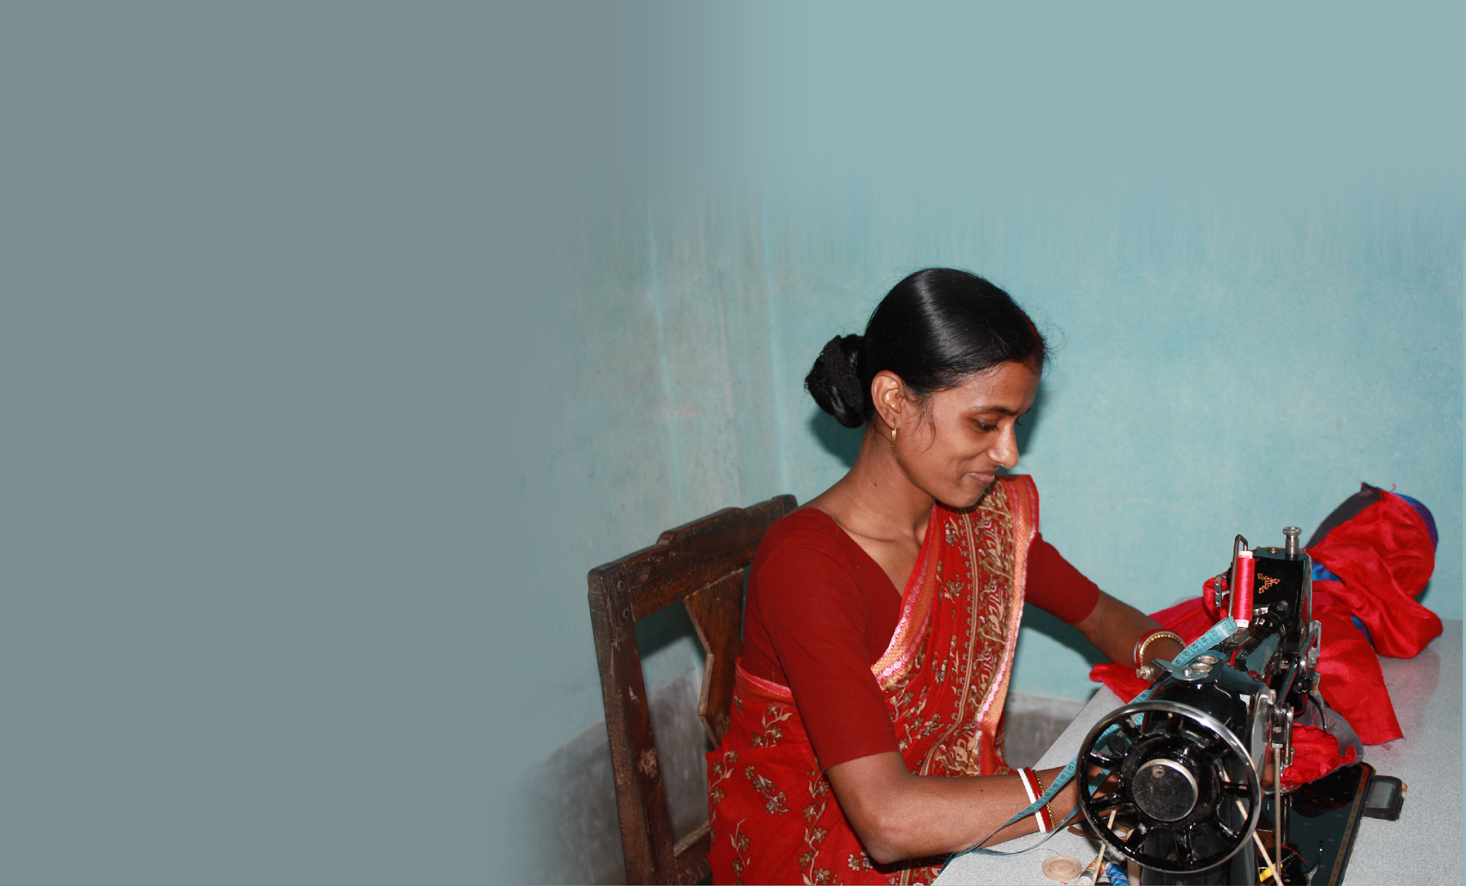

Why should #HRDD legislation cover informal homeworkers?
OED Due Diligence Forum on Business and Human Rights
25 February 2022.
Marlese von Broembsen, Law Programme Director, WIEGO

Slide 2
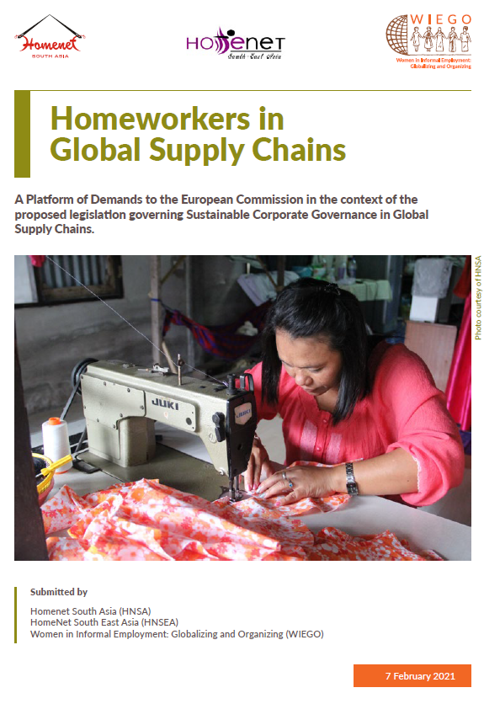
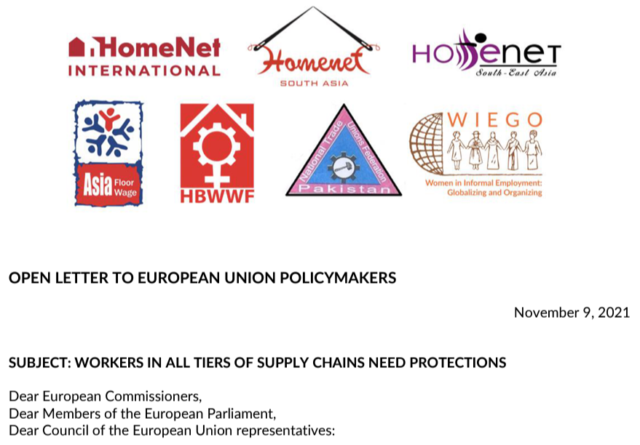
Platform of Demands
Open Letter
Notes:
FE b 2021 - 12 HW org
November 2021 – open letter 7 networks across 9 countries
Two key points (a) all workers in all tiers of the chain – both factory and subcontracted workers (b) access to justice

Slide 3
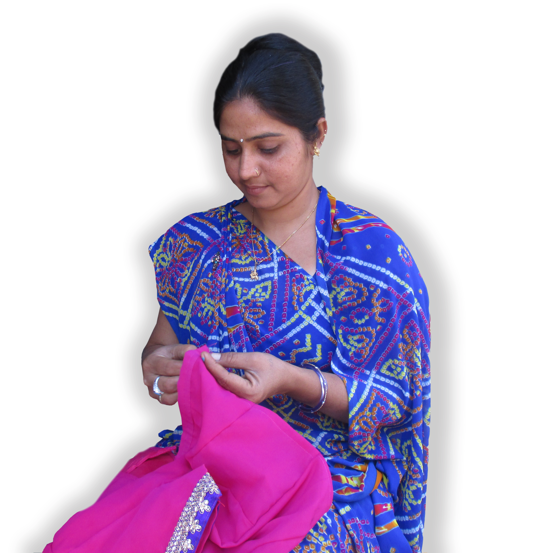
Contents
Why the Directive must go beyond factories
Why homeworkers must be included
Statutory incorporation of homeworkers
Demands by homeworker organisations

Slide 4
I. Arguments why the Directive must go beyond factories
It would ignore the real structure of the chain
It will lead to greater informalization of work ( LeBaron et al 2019) and exploitation of workers with impunity
The cost of improving labour rights of some workers will be borne by other workers
Including homeworkers is a gender issue

Slide 5
1. It will ignore the real structure of the Chain

Slide 6
Supply chain in Tiruppur, India
GLOBAL BRAND
FIRST-TIER SUPPLIER:
Export House
approx. 1500 workers
First-tier + second-tier
= 12.9 million workers
SECOND-TIER SUPPLIER
approx. 400 workers
Workshops:
6.6 million workers
Workshops:
10-80 workers
Contractor:
labour broker
Small workshops:
16,3 million workers
Small workshop
1-10 workers
Sub-contractor
Homeworkers:
5 million workers*
Homeworkers
Homeworkers
Homeworkers
Homeworkers
Homeworkers
*Raveendran et al 2013
Notes:
Almost 90 percent of workers employed outside factories
A 2019 study by Prof Mark Anner surveyed 340 garment factories in Delhi and Bengaluru - 58 percent of surveyed factories outsource to homeworkers.

Slide 7
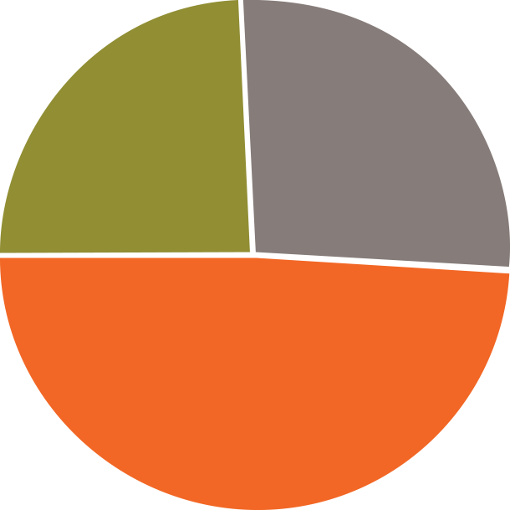
Indonesia (ILO 2015)
  National Labour Force Survey : only 29.4% on permanent contracts.
  25.8% engaged on fixed-term contracts (through intermediary).
  Trade unions: approximately 44,8% of textile workers are outsourced workers.
25,8%
Fixed-term contracts
29,4%
Permanent contracts
44,8%
Outsourced workers
Notes:
Important to remember that these are pre-covid figures. We know from AFWA’s extensive surveys that during covid, significant numbers of workers are being informalized.

Slide 8
2. It will drive informalization of work

Slide 9
The informalization of work
Standard Employment
Non-standard Employment
  Permanent
1
Temporary (fixed-term; casual)
  Full-time
2
Part time (<35 hours per week)
  Direct supervision on employers’ premises
3
Off premises: subcontracted outwork, homework
  Bilateral relationship between employer and employee
4
Engaged through intermediary
  Labour broker (fixed term contract)
  Homeworkers
Notes:
What do we mean by informalization of work?

Slide 10


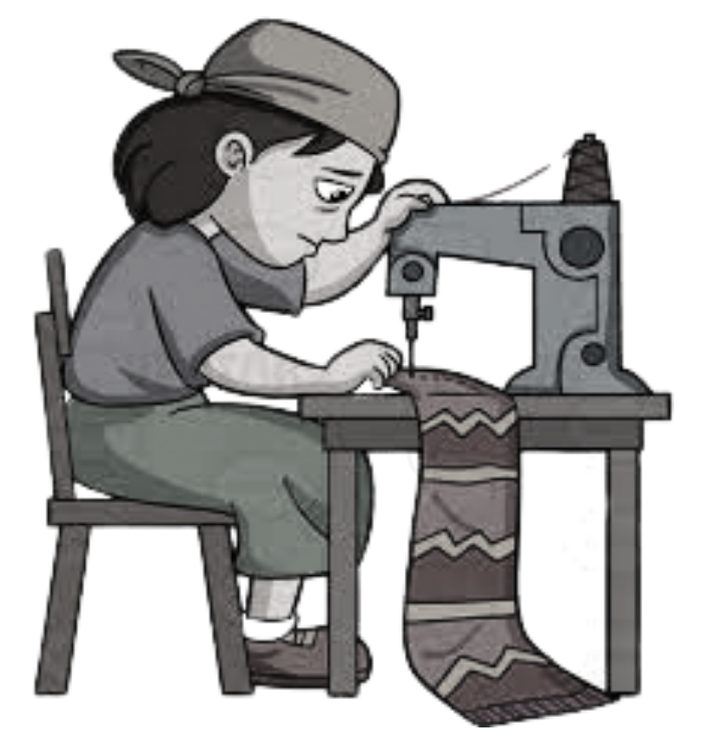
Brands and retailers’ purchasing practices
Tight deadlines
Price Pressure
Fluctuating demand
Garment Factories:
Overtime work without pay + subcontracting
Download costs and risks onto workers
Notes:
This slide serves to remind us of supply chain dynamics
A CCC study of 40 factories in eight garment and footwear producing countries found it is common practice for suppliers to maintain one factory that complies with codes while subcontracting to unaudited factories.. A Cornell study in 2021 that interviewed auditors revealed that auditors know that this practice is ubiquitous. This practice will contiue and be intensified if the due diligence fails to cover the whole chain.
.

Slide 11
Why support homeworkers specifically: it’s a gender issue !
Women can combine work and reproductive responsibilities
Older women can participate in the labour market
Village woman can participate in the labour market
Women whose cannot leave home to work because of cultural-religious norms, can participate in the labour market.
Many homeworkers are artisans (e.g. embroidery)
Notes:
In focus groups in India and Thailand with HW, women argued that 12 hour days left too little time to fulfil social and household responsibilities. Women argued that they needed to work from home to care for their children, grandchildren and sick or disabled relatives.
In India 80 percent of factory workers are 16-25 years old ;
In Cambodia 95 percent are under the age of 35;
In Vietnam the average factory worker is 25 years old
In Thailand, most HW are older women laid off by factories focus group w Thai homeworkers stated that Thai factories do not hire people over forty.
In Indonesia, factory workers are forced to resign at 50.

Slide 12
3. The cost of labour rights for factory workers will be borne by workers at the bottom of the chain (Barrientos, Gereffi, Rossi )
Notes:
A 2012 study disaggregated supply chain workers to understand the impact of strategies to realise decent work for employees on other categories of workers. They concluded that if labour rights are only for some, not all workers, the cost of ‘upgrading’ some workers’ terms and conditions of work is borne not by factories or brands, but by other workers who are not covered by audits: informal workers in factories and subcontracted workers in workshops and at home. This is a gender issue: In the textile, garment and footwear sectors, 80 percent of the workforce is female and women are always found in the most insecure work: casual work paid by the piece and homework.

Slide 13
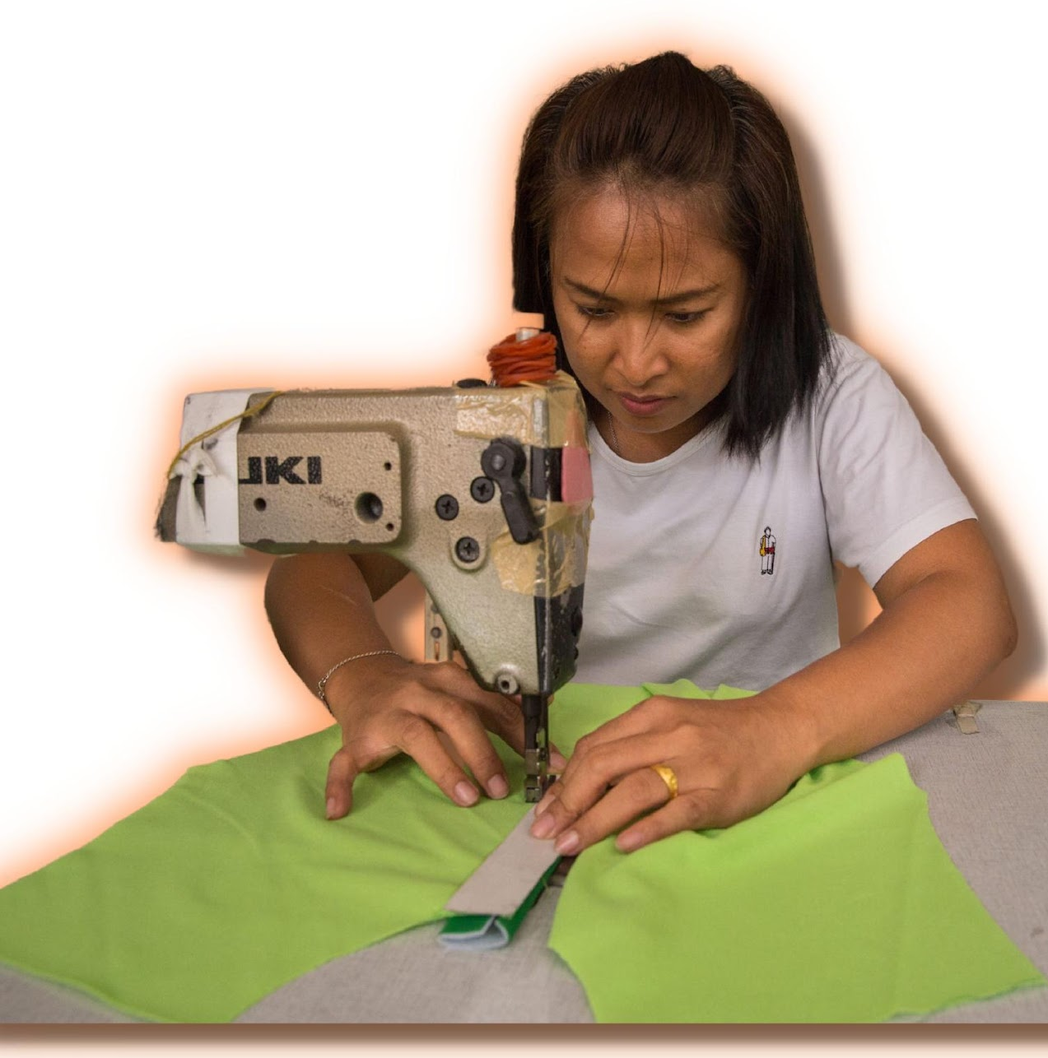
II. How can legislation include homeworkers
OECD Guidance Module 12
Australian Legislation
Homeworkers’ platform of demands

Slide 14
OECD Guidance Module 12 on Homework
Business should Include in their contracts with suppliers that suppliers must:
Keep a record of homeworkers, including the quantity of goods that
  homeworkers make and how much they are paid per piece;
  Record how long it takes to make each item and make sure the piece rate is enough to meet the minimum wage;
  Train factories and contractors about labour rights for homeworkers;
  Partner with organisations concerned with formalising homework; a
  Engage with national governments to provide homeworkers with rights to social security
Notes:
Legislation can make it madatory for enterprises to include a provision in their contracts with primary suppliers to keep a register of homeworkers and to require each tier of the chain to do the same. So it is a cascade effect - each tier require the tier below to comply.
This is the basic structure of the Australian model.
This is not perfect - encourage you to read the platform of demands.

Slide 15
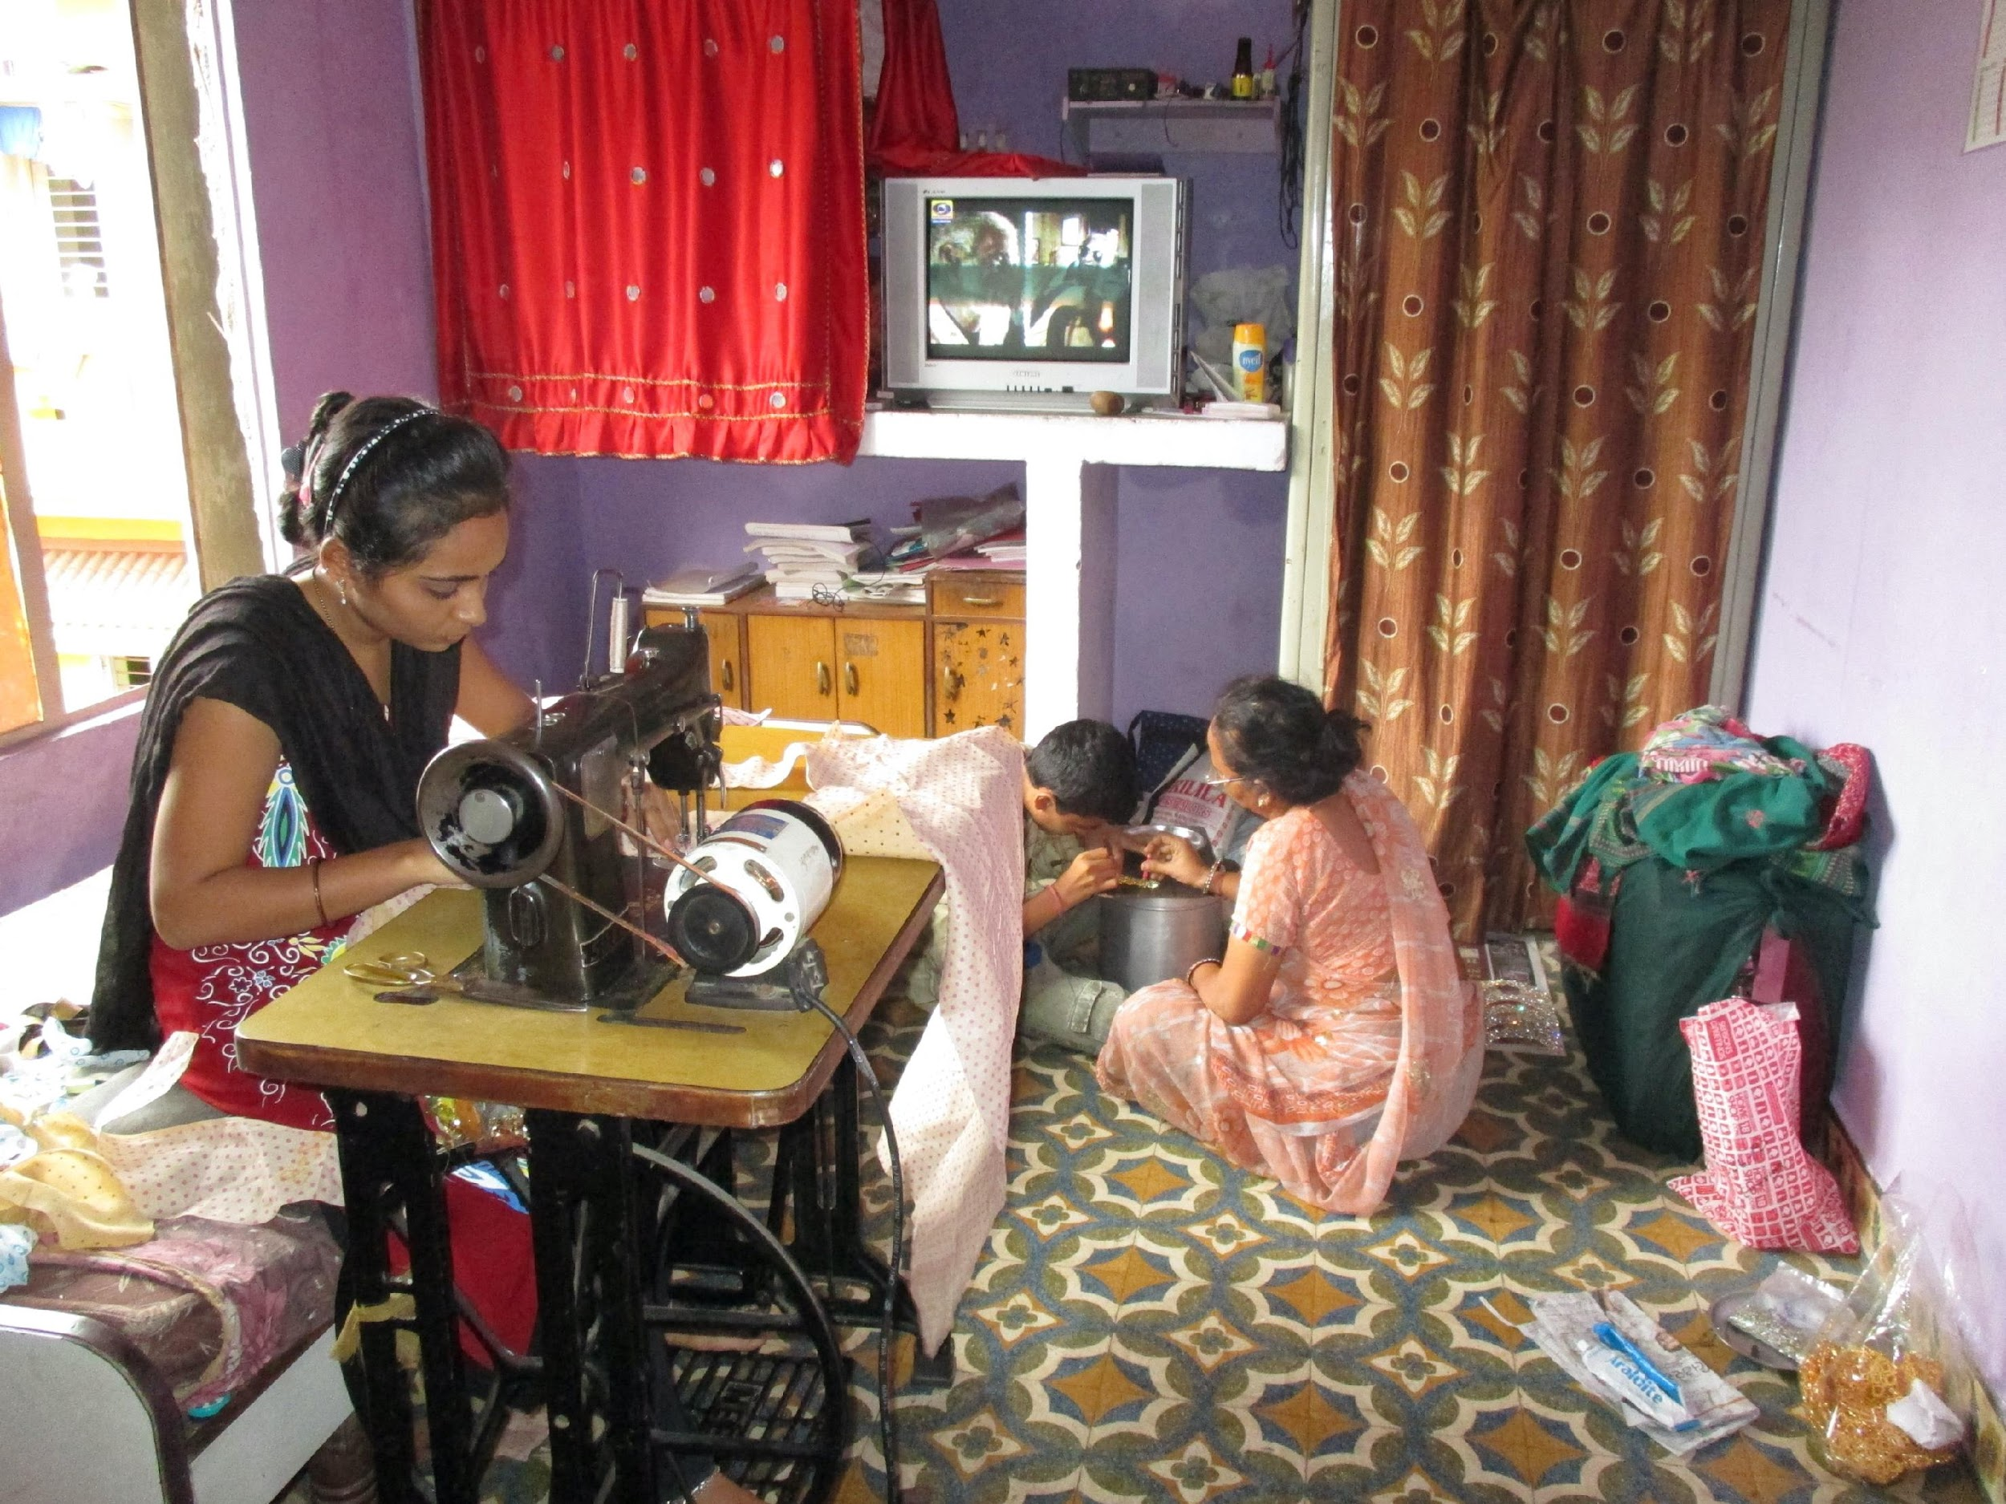
III. Homeworkers’ demands
Meaningful consultation
Transparency (contracts with the name of the brand)
Access to Justice
Notes:
Meaningful consultation on every aspect of due diligence

Slide 16
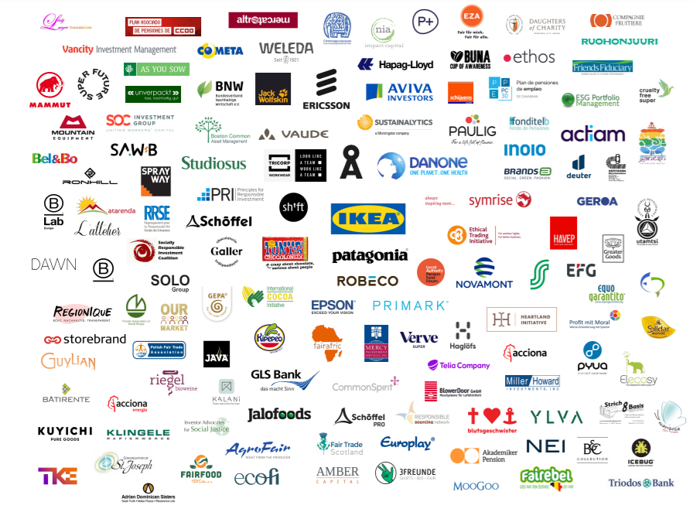
Brands support

Slide 17
Women in Informal Employment: Globalizing and Organizing (WIEGO) is a global network focused on empowering the working poor, especially women, in the informal economy to secure their livelihoods. We believe all workers should have equal economic opportunities, rights, protection and voice. WIEGO promotes change by improving statistics and expanding knowledge on the informal economy, building networks and capacity among informal worker organizations and, jointly with the networks and organizations, influencing local, national and international policies.
Visit www.wiego.org.

