Slide 1






What does Due Diligence in Homeworker Supply Chains look like?
Lucy Brill, Homeworkers Worldwide
OECD Side Session, 25th February 2022
Co- funded by the European Union

Slide 2
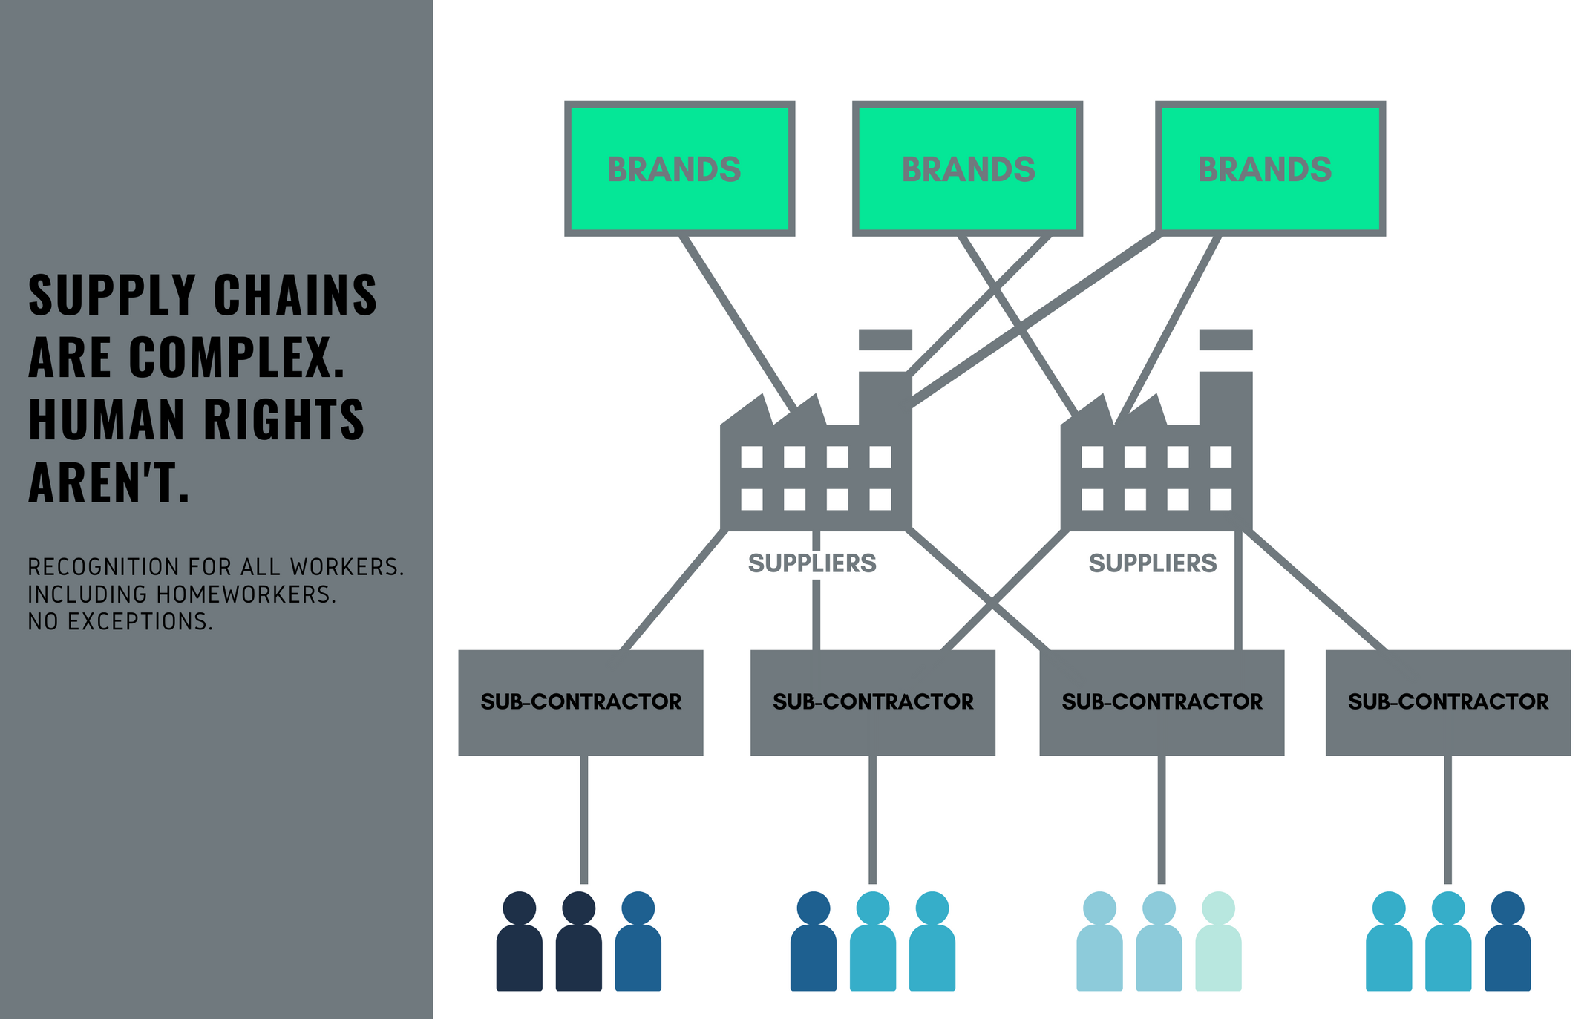
Notes:
Why tackle homeworking? First of all, the moral argument – it’s the right thing to do ..

Slide 3
Prevalence - 11% of all women workers work in their own homes .. 37 million in India, 4m Pakistan (28% female workforce), but brands report China, Vietnam, Italy, Bulgaria, even UK ..
Homeworkers are likely to be the lowest paid women workers in your supply chain .. And they very rarely appear in audits
90% homeworkers are women = gender-positive impact on the most vulnerable women workers in your chains
Transparency reduces the risk of child labour and other reputational risks hidden in sub-contract chains
Good employment of homeworkers retains skilled women workers in the workforce, ensuring production capacity of high quality specialist hand-worked products
Why Tackle Homeworking?
Notes:
But there are other important reasons why homeworking should feature in a brand’s due diligence plan ..
ILO estimates globally 8% workers (11% of all women workers) work in their own homes (≈100-300 million)
Garments (embellishment, checking, knitting)
Footwear (hand-stitching, moccasins, boat shoes)
Hand-crafted products (weaving, jewellery, metal-work, ceramics)
Packing (components, gift packs)
............... Diverse, fluid, changeable
“Every aisle of every shop”

Slide 4
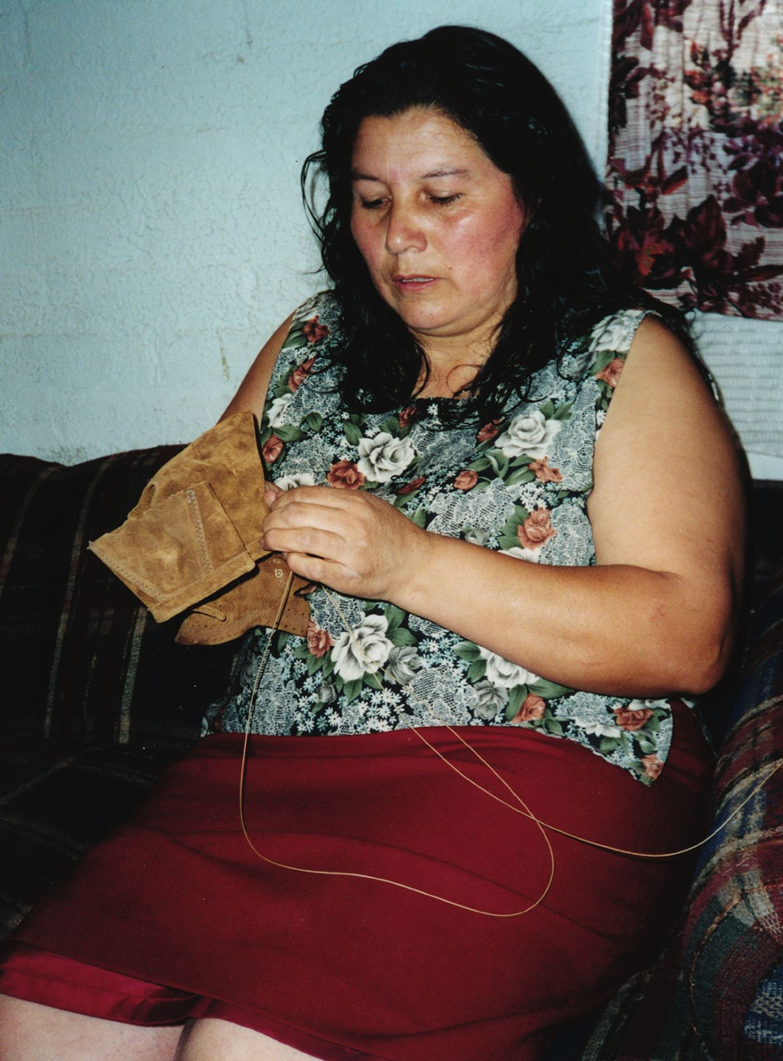
Case Study:
Leather Footwear
Typical labour intensive hand-stitching work
Leather uppers – loafers, high quality shoes
Paid piece rate, for each shoe sewn
Skilled work, producing high quality product
Stable supply chains

Slide 5

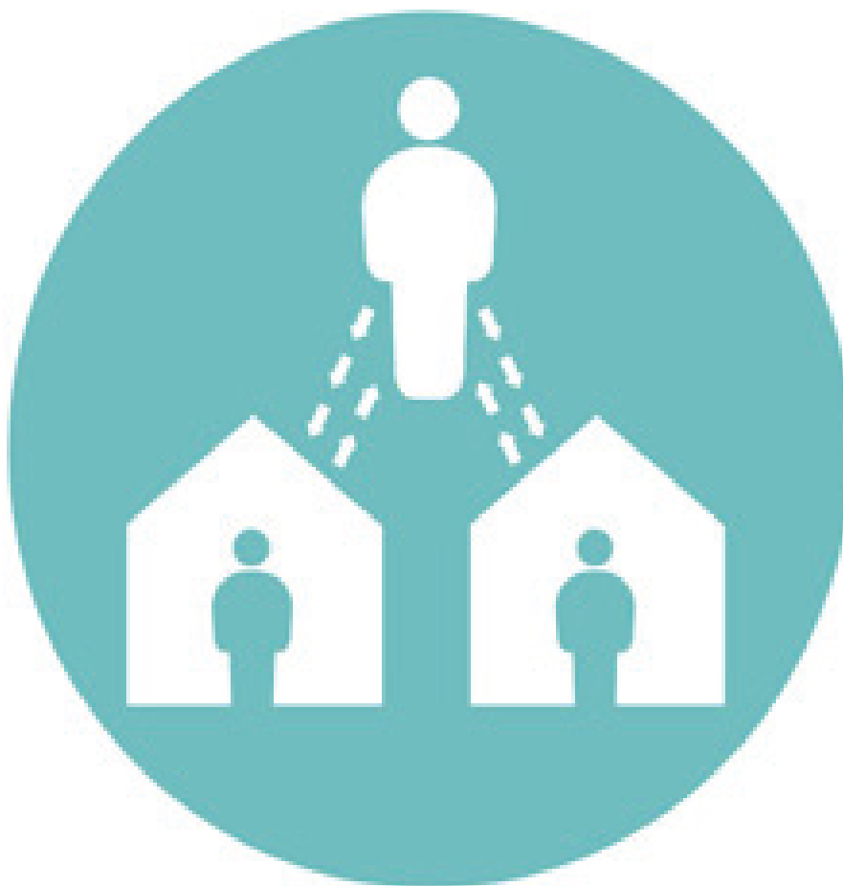

Case Study:
Tracing Supply Chains
T1 Supplier
1. Trust building with Supplier
2. Mapping informal sub-contract chain
  ~ 6 agents and 118 homeworkers
3. Needs assessment of homeworkers
  Very low incomes, well below outgoings
  Substantial debt to external lenders
  4. Value chain mapping
Following specific shoe styles & prices paid
Time & motion study to link to Minimum Wage
Flow of work and its impact
Possible impact of Purchasing Practices
Agent
Chief’ Homeworker
Homeworkers
Notes:
On the strength of our report Stitching our shoes’ a major UK Brand collaborated with HWW and its local partner in India to map the conditions of homeworkers which had been disclosed by one of its footwear suppliers in Tamil Nadu, S India.
A needs assessment was carried with a sample of homeworkers
Time was needed to build trust and communicate the aims of the mapping with the supplier and with agents so that they would disclose homeworking and allow interviews to rake place.

Slide 6
Supplier willingness to disclose
- Suppliers fear they will lose orders
Understanding how to monitor & implement
Cost (labour & implementation)
Weak position of women homeworkers employed informally in dispersed chains
Without a voice
Out of sight, out of mind
Negative/Mixed messages from Brands
Prohibition of homeworking & sub-contracting
Cycle of concealment and denial
Barriers to Transparency

Slide 7

"The biggest barrier is the perspective of many Buyers which have institutionalised a message that homeworking is not tolerated, or a more subtle message that the presence of homeworking will create issues and a lot of work
These act as an incentive on suppliers not to mention the presence of homeworkers.
Suppliers keep up the impression that all the production is taking place in the factory.
This is a challenge because it prevents Brands from seeing homeworkers making their products."
Ines Kaempfer, Executive Director,
Centre for Child Rights & Business

Slide 8
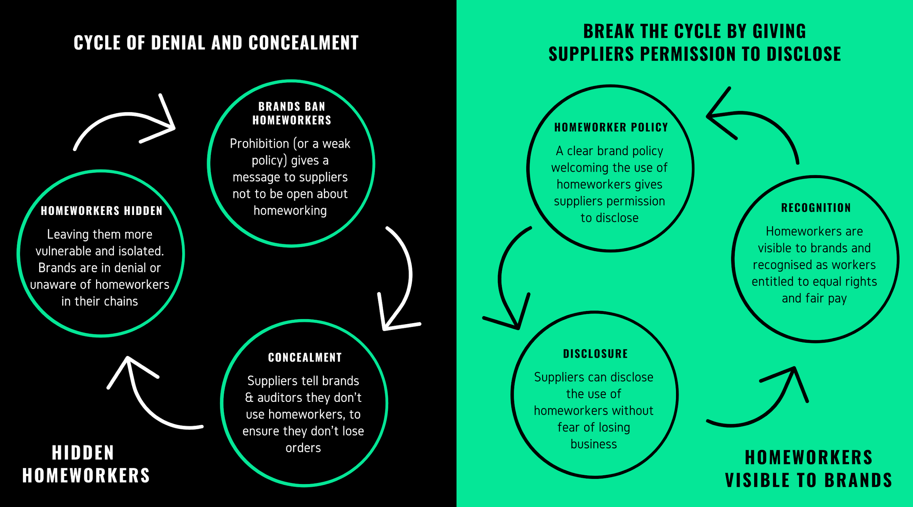

Slide 9
  Brand Homeworker Policy
Includes homeworkers in due diligence/implementation
Commits to work with supplier to address & improve
Gives permission to suppliers to disclose
Strong mutual brand supplier relationships
Brand purchasing practices
Stable platform for building trust & visibility
Mapping supply chains .. Brands working with local CSOs and Homeworker organisation, to map conditions and draw up Action Plan
Facilitators of transparency

Slide 10
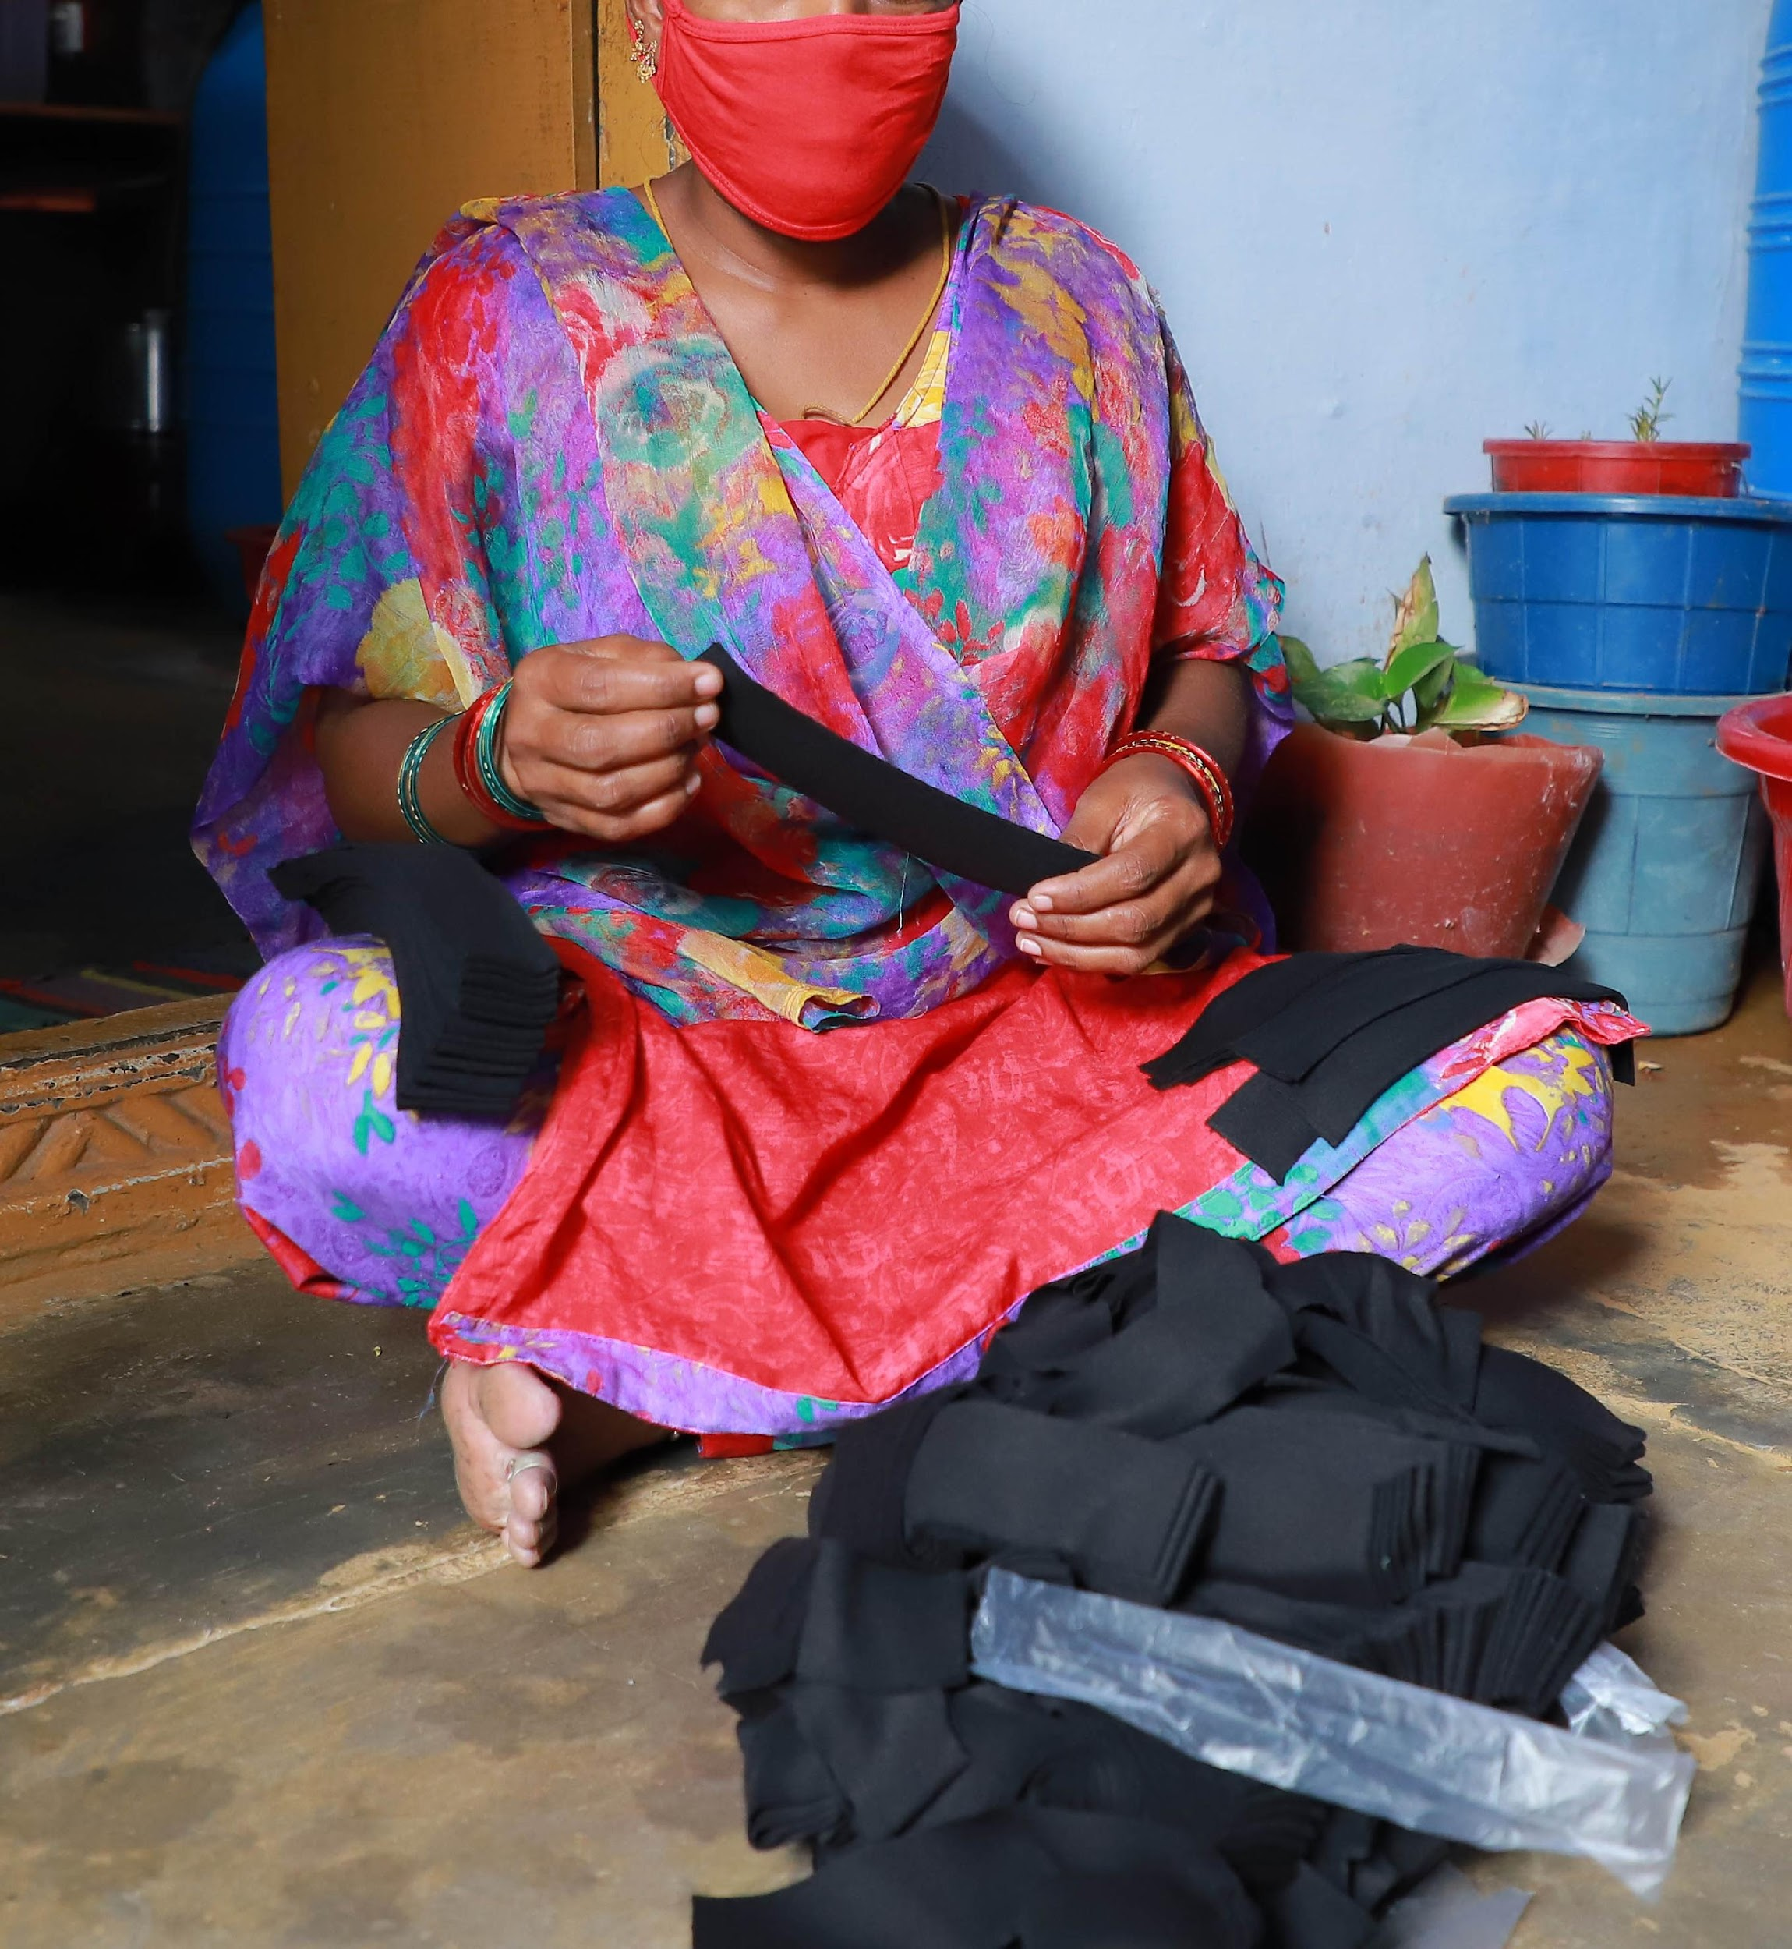
Sustainability
  Active involvement of homeworkers
- Dialogue over pay & conditions with suppliers
- Able to raise a grievance
- Able to ensure mechanisms are maintained
  Sector-wide adoption of transparency mechanisms
- Lowers transactional costs of mechanisms
- Consultation with local actors, local ownership
  Role of MSIs
- Sharing good practice
- Fomenting collaboration

Slide 11
  Building trust takes time
  Importance of a local CSO partner (gender, caste, religion)
  Collaborative approaches needed for sustainability – MSIs can help here
  Homeworker Policy is an essential first step
  Practical, tested tools for transparency in HW chains exist
  .. Check out our Hidden Homeworkers Toolkit to find out more!
Lessons Learnt

Slide 12
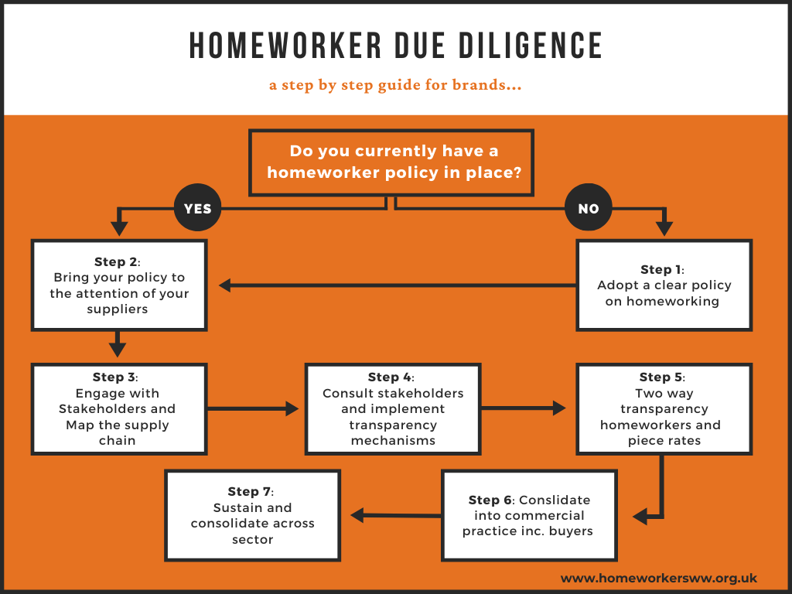
Notes:
Step 1: Adopt a clear policy on homeworking
Step 2: Bring your policy to the attention of your suppliers
Step 3: Engage with supply chain actors and map the supply chain
Step 4: Consult supply chain actors and implement transparency mechanisms
Step 5: Transparency over piece rates
Step 6: Giving homeworkers a voice: two way transparency to homeworkers
Step 7: Consolidate transparency into commercial practice
Step 8: Maintaining and sustaining transparency mechanisms

Slide 13

  Working with our partners, Homeworkers Worldwide offers resources to brands and suppliers to tackle these issues ..
  Through the Hidden Homeworkers Project in India, Pakistan and Nepal ..
  Through the HH Toolkit, available free on our website
  Also keen to find solutions and partners in other production locations
  Alongside vital role of national and international legislation in protecting homeworkers and driving change ..

Slide 14
To be effective in supporting homeworkers, legislation should:
Cover the whole supply chain, including sub-contractors, intermediaries and homeworkers
Include guidance to encourage responsible use of homeworkers
Explicitly recognise a living income as a human right ..
Include all areas of business activities, including purchasing practices
State that disengagement from suppliers using homeworkers should be a last resort
Require effective stakeholder engagement, including with homeworkers and their organisations
Establish a well-resourced regulator to issue guidance, receive complaints from victims, conduct individual and sectoral investigations, and apply sanctions.
Making mHREDD
work for Homeworkers

